Slide 1
We are what we repeatedly do. Excellence then, is not an act,
but a habit.
- Aristotle

Slide 2
RPMS ANNOTATIONS
Notes:
Objectives:
At the end of the activity, the participants should be able to:
-Understand Annotation and its importance
-Prepare and write Annotations

Slide 3
Objectives
RPMS ANNOTATIONS
1. Synthesize the concept on Annotation and its importance.
2. Share significant practices in preparing and writing annotation.
3. Display positive attitude in preparing and writing professional reflection annotation.
Notes:
Objectives:
At the end of the activity, the participants should be able to:
-Understand Annotation and its importance
-Prepare and write Annotations

Slide 4
RPMS ANNOTATIONS
Activity
Regroup your district into groups of 3.
Recall and brainstorm the lessons presented by the teacher during the demonstration teaching.
Notes:
Objectives:
At the end of the activity, the participants should be able to:
-Understand Annotation and its importance
-Prepare and write Annotations

Slide 5
RPMS ANNOTATIONS
Activity
Focus on the following:
- Domain
- Objectives
- Developmental Activity
- Instructional Materials used
Notes:
Objectives:
At the end of the activity, the participants should be able to:
-Understand Annotation and its importance
-Prepare and write Annotations

Slide 6
Activity
RPMS ANNOTATIONS
Individually in your group, choose 1 of the parts of the lesson where integration was evidently done which captured the interest of the learners during the delivery of the lesson.
Write a reflection about it.
In your group, take turns to share your reflection.
Notes:
Objectives:
At the end of the activity, the participants should be able to:
-Understand Annotation and its importance
-Prepare and write Annotations

Slide 7
Let’s share thoughts
RPMS ANNOTATIONS
What made you choose such part of the lesson?
How did it help the learners learn?
If you are the teacher, how will you do it differently?
How will you help yourself as a teacher to capture everything you’ve done that helps you improve the delivery of your lesson?
Notes:
Objectives:
At the end of the activity, the participants should be able to:
-Understand Annotation and its importance
-Prepare and write Annotations

Slide 8
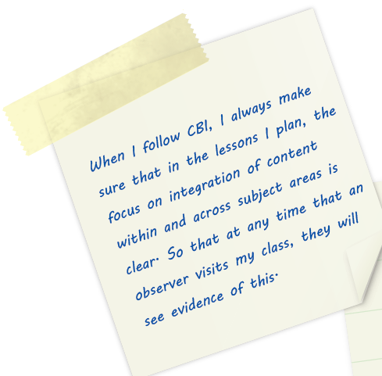
What are Annotations?
RPMS ANNOTATIONS
Annotations are self-reflections, explanations or presentational mark-ups attached to documents, artifacts or Means of Verification (MOV) that you submit for the RPMS.
Notes:
A teacher’s path towards personal growth and professional development involves reflection and learning in order to improve practice. One way of doing this is to become more actively engaged in the process of careful introspection and critical evaluation of your teaching practice. An essential step towards becoming a more reflective practitioner is through writing annotations in your professional development portfolios.

Slide 9
What are Annotations?
RPMS ANNOTATIONS
They are important in instances when the evidences or artifacts presented in teacher portfolios cannot capture the whole dynamics of the teaching and learning process.
Notes:
ARTIFACTS because these are valuable materials. Their worth is more than any a piece of paper……….. Annotations are important that the teacher has not been rated finally. This explains that whenever the classroom observation is conducted and the observers were not able to recognize one important thing that occurred in the entire delivery of lesson. With this, the teacher may be appeal to the evaluators for that certain aspect that the evaluators have missed during the post conference.

Slide 10
What are Annotations?
RPMS ANNOTATIONS
Further, annotations establish a connection between the evidences and the Rater; thus, facilitating the review of the portfolio. .
Notes:
A teacher’s path towards personal growth and professional development involves reflection and learning in order to improve practice. One way of doing this is to become more actively engaged in the process of careful introspection and critical evaluation of your teaching practice. An essential step towards becoming a more reflective practitioner is through writing annotations in your professional development portfolios.

Slide 11
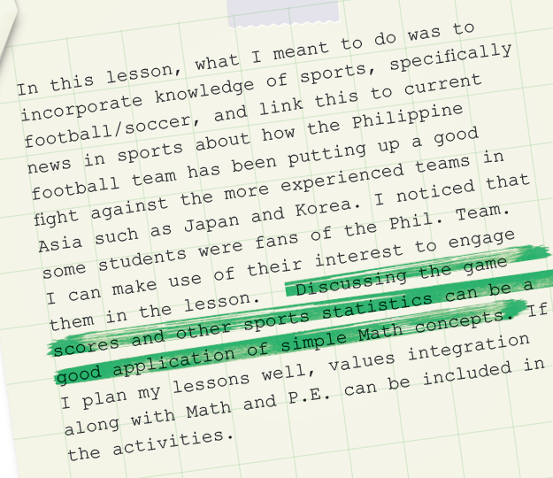
What is the importance of Annotations?
RPMS ANNOTATIONS
Annotations allow you to exercise reflective thinking.
They help you describe your teaching experiences and explain instructional decisions.
Notes:
This would refer to the deviations you made in the midst of your delivery of classroom instruction which is not found on the DLP as planned.

Slide 12
Why are Annotations important?
RPMS ANNOTATIONS
Annotations are important because they:
Make your evidences speak on your behalf;
Highlight your professional strengths in teaching;
Help you reflect on your teaching practices that pave the way for professional advancement;

Slide 13
What are Annotations important?
RPMS ANNOTATIONS
Annotations are important because they:
Describe your intentions, goals and purposes towards career growth;
Present and explain credentials required by the Rater for ranking and promotion; and
Make it easier for the Rater to rate your performance.

Slide 14
What do you Annotate?
RPMS ANNOTATIONS
When writing annotations, you need to present evidence of good practice in the various Key Result Areas.

Slide 15
What do you Annotate?
RPMS ANNOTATIONS
The following are possibilities for annotations:
1. Documents/artifacts that show your creativity and resourcefulness in teaching;

Slide 16
What do you Annotate?
RPMS ANNOTATIONS
The following are possibilities for annotations:
2. Evidences that may fully satisfy the requirements of the performance indicators but do not clearly demonstrate their link to the indicators themselves; and

Slide 17
What do you Annotate?
RPMS ANNOTATIONS
The following are possibilities for annotations:
3. Classroom context that explains your teaching practice and the realities you face in the classroom/school/community context.

Slide 18
Guide in writing annotations for a particular MOV in the Portfolio
RPMS ANNOTATIONS
Step 1. Describe the Means of Verification (MOV) that you want to annotate.
The following questions may help you describe the MOV that you want to annotate:
a. What is my MOV about?
b. How does my MOV meet the KRA’s objectives?
Notes:
These questions may guide your reflection:
What documents showcase my creativity and resourcefulness?
What evidences address the requirements of the performance indicators?
What classroom contexts explain my practices?

Slide 19
Guide in writing annotations for a particular MOV in the Portfolio
RPMS ANNOTATIONS
Step 2. Reflect on your MOV.
These questions may guide your reflection:
How does my MOV meet the objective?
What do I wish to highlight in my MOV in relation to the objective?
What classroom contexts explain my practices as reflected in my MOV?
Notes:
These questions may guide your reflection:
What documents showcase my creativity and resourcefulness?
What evidences address the requirements of the performance indicators?
What classroom contexts explain my practices?

Slide 20
Objectives | Means of Verification | Description of the MOV Presented | Annotations
1. Applied knowledge of content within and across curriculum teaching areas. | Classroom observation tool (COT) rating sheet and/or inter-observer agreement form about knowledge of content within and across curriculum teaching areas Lesson plans/modified DLLs developed highlighting integration of content knowledge within and across subject areas Instructional materials highlighting mastery of content and its integration in other subject areas Performance tasks/test material(s) highlighting integration of content knowledge within and across subject areas Others (Please specify and provide annotations) | The MOV presented was a lesson plan that showed integration of knowledge and content in Physical Education | In this lesson, I incorporated knowledge of sports, specifically football/soccer to my Math lesson. To get students interested, I drew attention to the sports news about how the Philippine team had been putting up a good fight against more experienced teams in Asia, such as Japan and Korea. To apply Math concepts, I led the class in discussing the game scores and other sports statistics. My students were engaged. I was able to deliver my lesson in Math with an interesting focus on sports.
/

Slide 21
Objectives | Means of Verification | Description of the MOV Presented | Annotations
1. Applied knowledge of content within and across curriculum teaching areas. | Classroom observation tool (COT) rating sheet and/or inter-observer agreement form about knowledge of content within and across curriculum teaching areas Lesson plans/modified DLLs developed highlighting integration of content knowledge within and across subject areas Instructional materials highlighting mastery of content and its integration in other subject areas Performance tasks/test material(s) highlighting integration of content knowledge within and across subject areas Others (Please specify and provide annotations) | The MOV presented was a lesson plan that showed integration of knowledge and content in Physical Education | In this lesson, I incorporated knowledge of sports, specifically football/soccer to my Math lesson. To get students interested, I drew attention to the sports news about how the Philippine team had been putting up a good fight against more experienced teams in Asia, such as Japan and Korea. To apply Math concepts, I led the class in discussing the game scores and other sports statistics. My students were engaged. I was able to deliver my lesson in Math with an interesting focus on sports.
/
The MOV presented was a lesson plan that showed integration of knowledge and content in Physical Education.

Slide 22
Objectives | Means of Verification | Description of the MOV Presented | Annotations
1. Applied knowledge of content within and across curriculum teaching areas. | Classroom observation tool (COT) rating sheet and/or inter-observer agreement form about knowledge of content within and across curriculum teaching areas Lesson plans/modified DLLs developed highlighting integration of content knowledge within and across subject areas Instructional materials highlighting mastery of content and its integration in other subject areas Performance tasks/test material(s) highlighting integration of content knowledge within and across subject areas Others (Please specify and provide annotations) | The MOV presented was a lesson plan that showed integration of knowledge and content in Physical Education | In this lesson, I incorporated knowledge of sports, specifically football/soccer to my Math lesson. To get students interested, I drew attention to the sports news about how the Philippine team had been putting up a good fight against more experienced teams in Asia, such as Japan and Korea. To apply Math concepts, I led the class in discussing the game scores and other sports statistics. My students were engaged. I was able to deliver my lesson in Math with an interesting focus on sports.
In this lesson, I incorporated knowledge of sports, specifically football/soccer to my Math Lesson. To get students interested, I drew attention to the sports news about how the Philippine team had been putting up a good fight against more experienced teams in Asia, such as Japan and Korea. To apply Math concepts, I led the class in discussing the game scores and other sports statistics. My students were engaged. I was able to deliver my lesson in Math with interesting focus on sports.
/

Slide 23
RPMS ANNOTATIONS
Activity 2
Instructions:
In small groups, choose an MOV to be annotated for KRA 1 Objective 1.
Write annotations for the MOV using the Annotation Template.
Notes:
Application:
After the discussion, Activity 2: In small groups, identify specific scenarios or illustration of practices and MOV for these scenarios. Then write annotations for the MOV using the Annotation Template.
Ask them to present their outputs afterwards.

Slide 24
RPMS ANNOTATIONS
GALLERY WALK
Notes:
Application:
After the discussion, Activity 2: In small groups, identify specific scenarios or illustration of practices and MOV for these scenarios. Then write annotations for the MOV using the Annotation Template.
Ask them to present their outputs afterwards.

Slide 25
RPMS ANNOTATIONS
What can you offer?
Post your group output in the your home group’s spot.
Select 2 member to stay as the “Taong Bahay”.
As a group, you will move from one spot to another and ask the “Taong Bahay” as many questions as you can within 3 minutes.
Notes:
Application:
After the discussion, Activity 2: In small groups, identify specific scenarios or illustration of practices and MOV for these scenarios. Then write annotations for the MOV using the Annotation Template.
Ask them to present their outputs afterwards.

Slide 26
RPMS ANNOTATIONS
What can you offer?
After 3 minutes, move to another home groups and the same process until you reach to your own home group.
Moving shall be done counter clockwise.
If you’re done, shout out loud your battle cry.
Notes:
Application:
After the discussion, Activity 2: In small groups, identify specific scenarios or illustration of practices and MOV for these scenarios. Then write annotations for the MOV using the Annotation Template.
Ask them to present their outputs afterwards.

Slide 27
RPMS ANNOTATIONS
A teacher’s path towards personal growth and professional development involves reflection and learning in order to improve practice. One way of doing this is to become more actively engaged in the process of careful introspection and critical evaluation of your teaching practice. An essential step towards becoming a more reflective practitioner is through writing annotations in your professional development portfolios.
Notes:
Application:
After the discussion, Activity 2: In small groups, identify specific scenarios or illustration of practices and MOV for these scenarios. Then write annotations for the MOV using the Annotation Template.
Ask them to present their outputs afterwards.

Slide 28
RPMS ANNOTATIONS
A good teacher is like a candle, it consumes itself to light the way for others.” -Mustafa Kemal Ataturk
Notes:
Application:
After the discussion, Activity 2: In small groups, identify specific scenarios or illustration of practices and MOV for these scenarios. Then write annotations for the MOV using the Annotation Template.
Ask them to present their outputs afterwards.

