Slide 1
Session 1:
Session 1:
Demonstration Teaching
(COT-RPMS)

Slide 2
Wisdom-Sharing
Discover
your
purpose, values, vision, goals, motivations, beliefs.
That is who you are.
DEPARTMENT OF EDUCATION
Notes:
What did you do when these thoughts got into your mind?
What have you discovered when you gave in to these thoughts?

Slide 3
OBJECTIVES:
Integrate personal experiences in understanding the COT-RPMS Processes and Tools.
Share KSAs on the effective use of COT-RPMS processes and tools.
Display optimism in enhancing the
competencies in coaching and
mentoring as core elements in
Instructional Supervision.

Slide 4
Demonstration Teaching

Slide 5
Activity 1: Actual Demonstration Teaching
Group yourselves by triad. Assign each member of your triad with a corresponding letter, e.g. A, B, and C.
You will be provided with copies of COT-RPMS Manual.
Letter | Role
A | Master Teacher
B | Head Teacher
C | Principal

Slide 6
Activity 1: What’s Up!
In your triad, discuss the Pre-, During, and Post COT-RPMS process.
Use the COT-RPMS Tools, such as:
-Rubric
-Observation Notes Form
- Rating Sheet
- Inter-observer Agreement Form
Get ready for the actual Demonstration teaching.

Slide 7
Actual Demonstration Teaching

Slide 8
Activity 2 : What’s Your Stake? (45 minutes)
In your triad, discuss the result of your rating and come up with the consensual final rating. Do it collaboratively in 15 minutes.
Translate what you have written in your COT-RPMS Observation Notes Form to STAR Observation in 30 minutes.
After the specified time, take turns to share your STAR among the three of you in your triad.

Slide 9
Activity 3 : Collaborate, and Integrate
Choose one from your triad to discuss the result of the Consensual Rating.
Collaboratively write a Reflection about the COT-RPMS Process.
Share your reflection in plenary.

Slide 10
Let’s share
What did you see in the observation that led you to give the rating?
Was there anything in the teacher that hinder/s you to give the rating?
How did the teacher show the indicator?
What part of the lesson that you believe had given greater impact?
What are your realizations?

Slide 11
Wisdom Sharing
COT-RPMS Is one subset of the classroom observation tool (COT)
RA 10533, otherwise known as K to 12 law, features classroom observation as one gauge in ensuring quality teaching. Section 14 of the law indicates that the department will report on different aspects needed in the implementation that includes teacher welfare and training needs which may be measured via teacher classroom observation.

Slide 12
Wisdom Sharing
Feedback provides quality input for the continuous improvement of teacher practice and provides opportunities to share ideas and expertise, as well as, promote mentoring and coaching among colleagues.
The new classroom observation tool is PPST-based.
There are two COT for RPMS: one for teachers (proficient) and another for master teachers (highly proficient).

Slide 13
The COT rating will be used as a means of verification in the RPMS tool.
A teacher will get a COT based on his/her position following the RPMS tools: Proficient or Highly Proficient.

Slide 14
The COT rating will be used in four KRAs: 1. Content Knowledge and Pedagogy; 2. Learning Environment and Diversity of Learners; 3. Curriculum and Planning; and 4. Assessment and Reporting.

Slide 15
Teacher I-III (Proficient Teachers) have 9 indicators in the COT-RPMS.
Master Teachers (Highly Proficient Teachers) have 5 indicators in the COT-RPMS.

Slide 16
It his highly recommended that only the Observation Notes Form will be brought by the observer/s during the actual observation.
Bringing ONLY the Observation Notes Form allows the observer to focus on the teacher’s performance.

Slide 17
Writing Professional Reflection

Slide 18
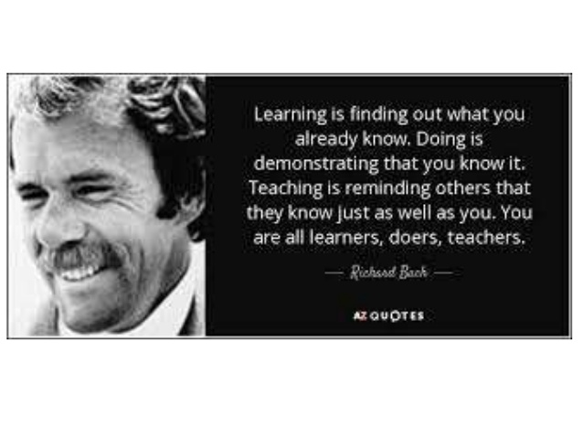

Slide 19
To God
be the glory!

