Slide 1
ITS ALIGNMENT TO THE OTHER SYSTEMS

Slide 2
Session Objectives
Discuss the alignment of the PPST resource package to the other systems;
Propose measures that schools have to implement to ensure that PPST resource package is utilized and integrated with other learning and development activities; and
Display sensitive awareness on the importance of PPST and its resource package.

Slide 3
System/Process/Program | Your group’s general understanding of this system/process/program
PPST
RPMS
TIP

Slide 4
What’s in the PSST Resource Package for us?

Slide 5
SYSTEM
SYSTEM

Slide 6
another BURDEN?
Notes:
SAY: Many teachers may look at it as another burden.

Slide 7
another WORK LOAD?
Notes:
SAY: “Other’s may say, It’s another work load”

Slide 8
encourage the teachers to become the better version of themselves
TEACHER 2.0
Notes:
SAY: There should be a positive messaging that this resource package is made to encourage the teachers to become the better version of themselves; the Teacher 2.0

Slide 9
PPST
-Career Stages
-Domains
-Strands
-Indicators

Slide 10
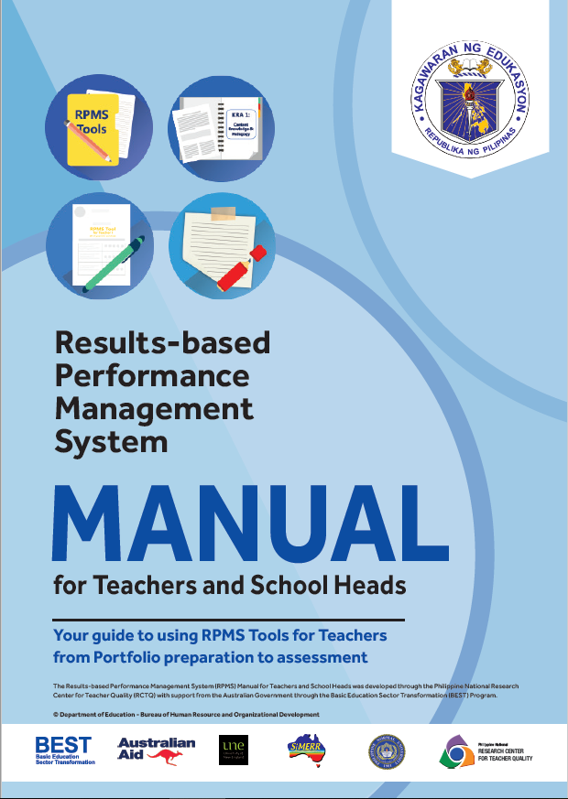
RPMS
-RPMS Tools
IPCRF
Self-Assessment Tool
Classroom Observation Tool
Individual Development Plan

Slide 11
P P S T
Resource Package
-12 Indicators
-12 Indicators aligned in the IPCRF Tool in the RPMS

Slide 12
Let’s share ideas…
Discussion of the Mechanics and Conditions of the Game | 15 minutes only
Inventing Team Codes
Mastery of team codes by all members
Actual Game | 20 minutes only
Do all the systems and processes related?
Do you have the same understanding of each system or process?
Why should school heads/PSDSs know the features of these systems and processes?

Slide 13
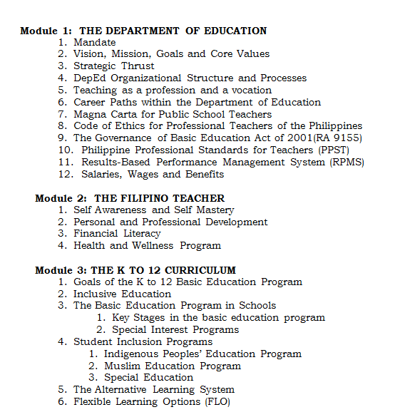
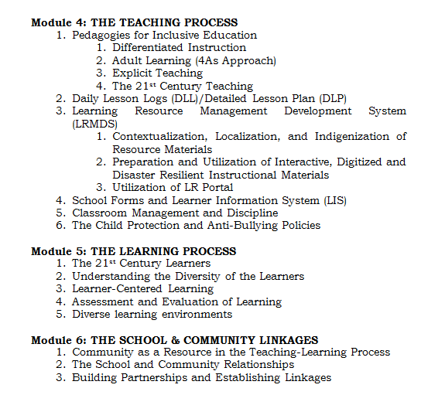
T I P Modules

Slide 14
RPMS Tools
12 Indicators
-Objectives
-Means of Verifications
-Performance Indicators

Slide 15
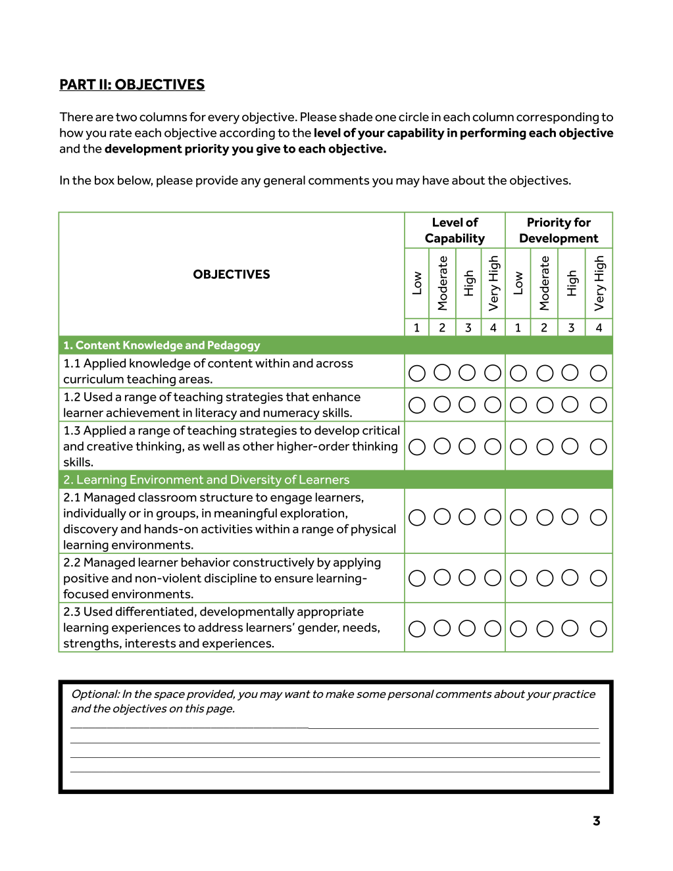
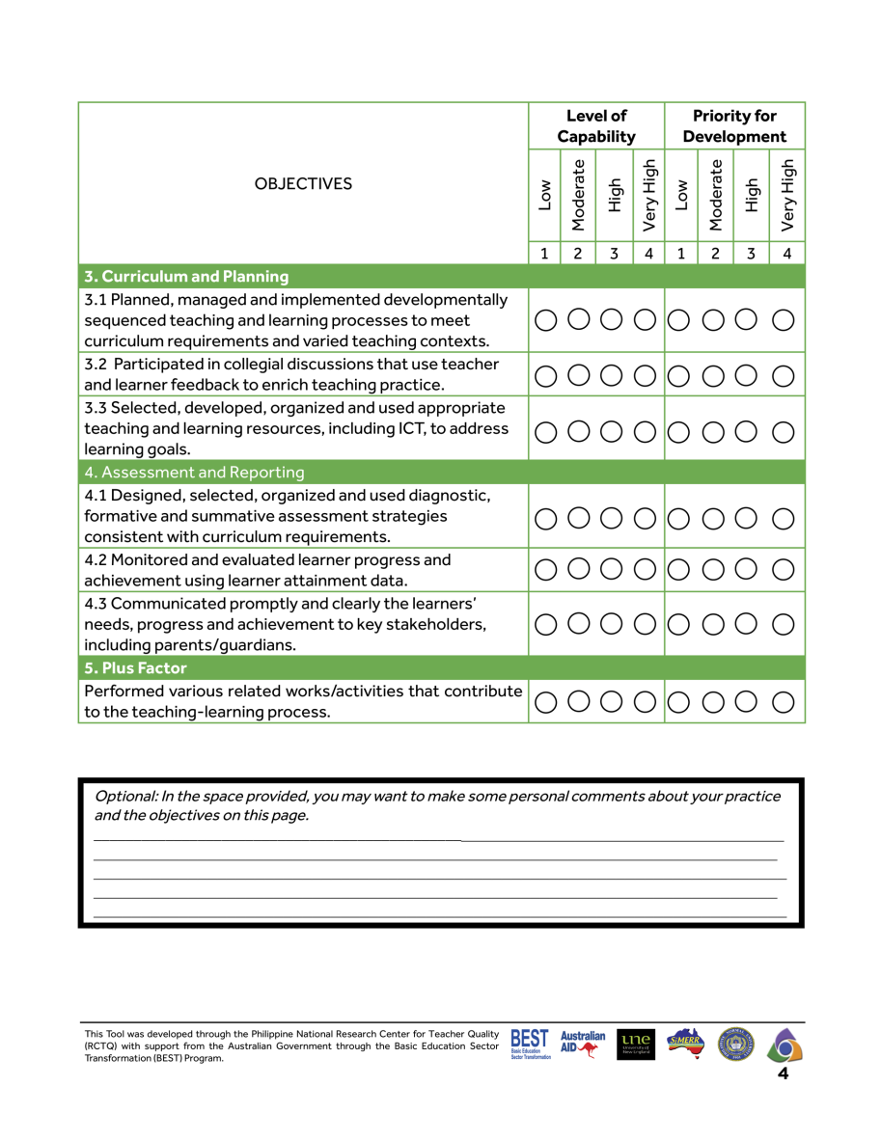
Self-Assessment Tool
12 Indicators for both Proficient and Highly Proficient

Slide 17
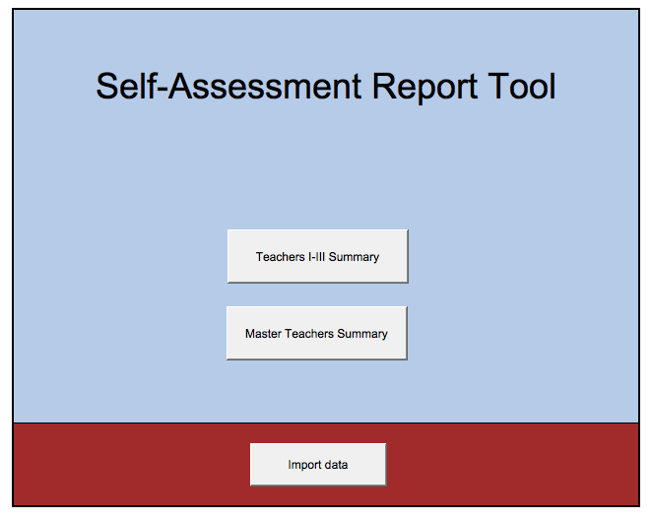
Teachers I-III Summary

Slide 18
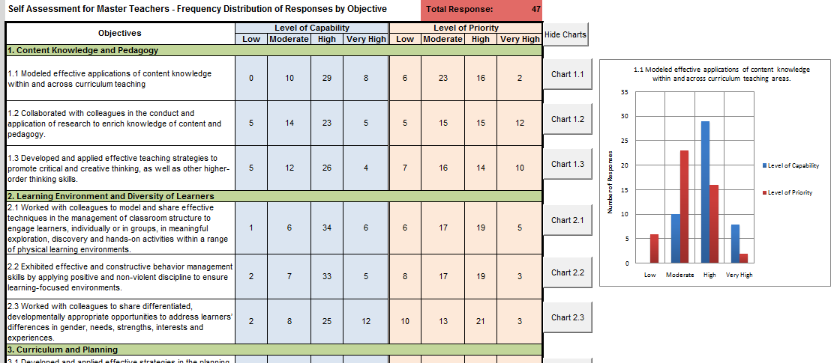
Master Teachers Summary

Slide 19
Very High: 5.1 (Plus Factor) 2.2 (Management of behavior) 3.2 (Collegial discussion) High: 1.1 (Content Knowledge and Pedagogy) 4.3 (Communication to key stakeholders); 4.2 (Monitoring and Evaluation); 2.1 (Classroom structure and activities)
Moderate:
3.3(Teaching and Learning Resources) 2.3 (Differentiated teaching strategies)
Low: 4.1 (Diagnostic, formative and summative assessment strategies)

Slide 20
Very High: 3.3 (Teaching and Learning Resources)
1.2 (Literacy and Numeracy Strategies)
1.3 (Critical and creative thinking; HOTS)
High: 4.1 (Diagnostic, formative and summative assessment strategies) 2.3 (Differentiated teaching strategies)
Moderate:
4.2 (Monitoring and Evaluation)
3.2 (Collegial Discussion)
1.1 (Content knowledge and pedagogy)
Low: 3.1 (Planning and Management of curriculum)
2.2 (Management of behavior)

Slide 21
Very High: 5.1 (Plus Factor) 3.1 (Planning and management of curriculum)
2.3 (Differentiated teaching strategies) High: 2.1 (Classroom structure and ativities)
2.2 (Managing learner behavior)
4.3 (Communication to key stake holders);
Moderate:
4.2 (Monitoring and Evaluation)
3.2 (Collegial discussion)
3.3 (Teaching and Learning resources
Low: 1.2 (Collaborated Action research)

Slide 22
Very High: 3.3 (Teaching and Learning Resources)
1.2 (Collaborated Action Research) High:
4.1 (Diagnostic, formative and summative assessment strategies)
2.3 (Differentiated teaching strategies)
Moderate:
4.2 (Monitoring and evaluation)
3.2 (Collegial discussion)
1.1 (Content Knowledge and Pedagogy)
5.1 (Plus Factor
Low: 2.3 (Differentiated teaching strategies)
2.2 (Managing learner behavior)

Slide 23
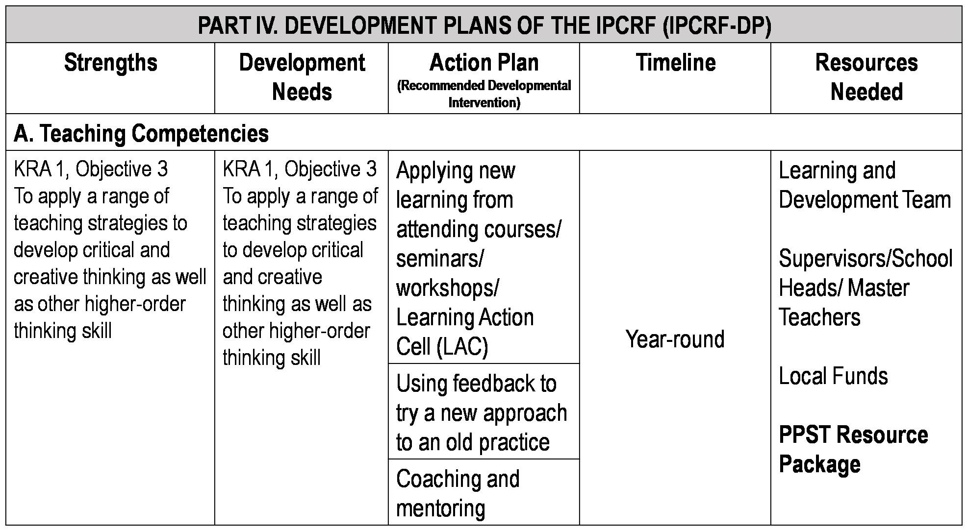

Slide 27
PART IV. DEVELOPMENT PLANS OF THE IPCRF (IPCRF-DP)
Strengths | Development Needs | Action Plan (Recommended Developmental Intervention) | Timeline | Resources Needed
A. Teaching Competencies
KRA 1, Objective 3 To apply a range of teaching strategies to develop critical and creative thinking as well as other higher-order thinking skill | KRA 1, Objective 3 To apply a range of teaching strategies to develop critical and creative thinking as well as other higher-order thinking skill | Applying new learning from attending courses/ seminars/ workshops/ Learning Action Cell (LAC) | Year-round | Learning and Development Team Supervisors/School Heads/ Master Teachers Local Funds PPST Resource Package
 |  | Using feedback to try a new approach to an old practice
 |  | Coaching and mentoring

Slide 28
Classroom Observation Tool

Slide 29
Classroom Observation Tool

Slide 30
ADDITIONAL
BURDEN & WORK LOAD

Slide 31
NEW PERSPECTIVE OF MENTORING AND COACHING

Slide 32
FRESH WAY TO HELP TEACHERS IMPROVE THEIR CURRENT PRACTICES

Slide 33
PUSHING THE TEACHERS TO MAXIMIZE THEIR POTENTIALS

Slide 34
TO BRING OUT THE BETTER VERSION OF THE TEACHER

Slide 35
MADE FOR TEACHERS BY TEACHERS

Slide 37
A teacher who needs to reflect on his/her lesson planning
MODULE 1

Slide 38
A teacher who needs to mentor another teacher on developing instructional materials
MODULE 9

Slide 39
A school head who needs to supervise teachers on choosing the appropriate assessment strategies
MODULE 10

Slide 40
A group of teachers who are part of the school-based LAC session who needs to tackle about monitoring and reporting learners’ needs
MODULE 12

Slide 41
A teacher who needs reference material for a small group discussion on the PPST indicators
MODULE 8

Slide 42
A teacher who needs prototype lessons per key stage and subject area
MODULE 1

Slide 43
A teacher who needs a guide for crafting contextualized performance-based activities
MODULE 6

Slide 44
A teacher who wants to take his/her time understanding the indicators
MODULE 8

Slide 45
An EPS who wants to share insights to a teacher on selecting activities that address learners’ needs and interests
MODULE 6

Slide 46
A teacher who wants to help another teacher understand and appreciate the indicators
MODULE 8

Slide 47
LET’S DO
THE WRAP UP

Slide 48
What are the possible uses of the PPST Resource Package?
✓reflect on your own classroom practices, and ensure that your teaching practices are aligned with the indicators;
Notes:
Ask questions on the following to share their own personal reflections as they walkthrough the 10 modules.

Slide 49
✓want to mentor beginning teachers so they become better in their practice;

Slide 50
✓are a part of a group of teachers who need materials for your school-based Learning Action Cell (LAC) sessions in order to (i) learn more about the PPST and (ii) innovate on practices using the samples in the resource material as guide;

Slide 51
✓want to develop or expand the current work by
(i) providing more examples of practices or
(ii) working on other career stages or indicators other than the 12 presented in this package.

Slide 52
2. Do you think these modules are useful in any situation you meet in school especially in the classroom?
Notes:
Ask questions on the following to share their own personal reflections as they walkthrough the 10 modules.

Slide 53
3. Can you give other instances or situations when the use of PPST Resource Package is needed?
Notes:
Ask questions on the following to share their own personal reflections as they walkthrough the 10 modules.

Slide 54
✓as reference material for small group discussions, teacher-to-teacher consultation, peer teaching and other events related instances;

Slide 55
✓as suggested material for developing lesson plan, performance tasks and enabling activities per key stage area and subject area;

Slide 56
✓as go-to guide in understanding the indicators;
✓as aid in self-paced learning of the indicators

Slide 57
4. What are your realizations after the walkthrough on each module?
Notes:
Ask questions on the following to share their own personal reflections as they walkthrough the 10 modules.

Slide 58
ENCOURAGE ONE ANOTHER AND BUILD EACH OTHER UP
Notes:
We need to encourage our dear teachers to practice all the domains and strands in order for them to grow professionally and we will help them to level up to the next carreer stage which is the highly proficient teachers in the future.

Slide 61
Mark Anthony P. Idang
SDO Laguna, Region IV-A CALABARZON
mark.idang@deped.gov.ph

