Slide 1
The Philippine Professional Standards for Teachers

Slide 2
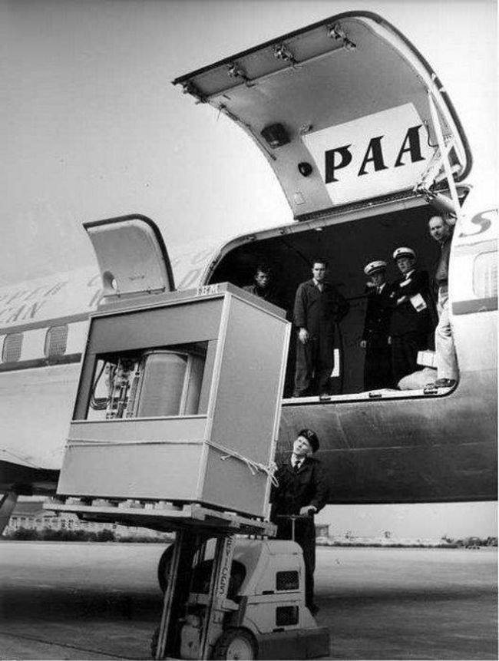
We sometimes forget how much things change over time
This is a Cargo Plane in 1956.
It is transferring a 5MB IBM Hard Drive.
A 256GB iPhone is more than 51,000 times that!
Source: http://forums.sherdog.com/threads/10-mb-hard-drive-from-the-60s-pic-tech-brahs-gtfih.3500915/

Slide 3
General Information on Department Order No. 42, s. 2017

Slide 4
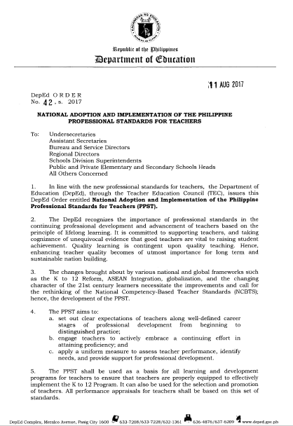
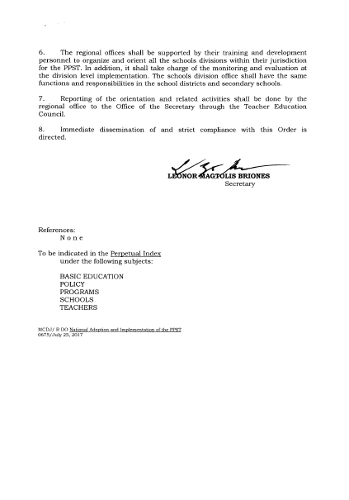
DepEd No. 42, s. 2017

Slide 5
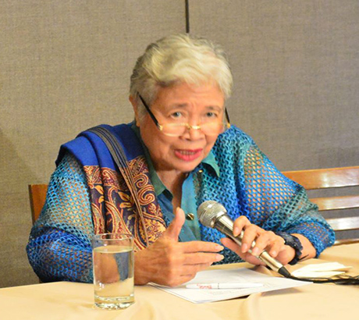
Secretary Briones signed into policy DepEd Order No. 42, S. 2017, The National Adoption and Implementation of the Philippine Professional Standards for Teachers.
http://media.philstar.com/images/the-philippine-star/headlines/20160707/leonor-briones.jpg

Slide 6
DO 42, S. 2017
The PPST:
sets clear expectations of teachers along well-defined career stages of professional development from beginning to distinguished practice;
engages teachers to embrace ongoing professional learning for their professional development to enhance their own teaching;
provides a framework of uniform measures to assess teacher performance; and
provides a basis for building public confidence in and support for the work of teachers.

Slide 7
From D.O. 42, s. 2017:
The PPST shall be used as a basis for all learning and development programs for teachers to ensure that they are properly equipped to effectively implement the K to 12 Program.
It can also be used for the selection and promotion of teachers.
All performance appraisals for teachers shall be based on this set of Standards.

Slide 8
What is the Philippine Professional Standards for Teachers (PPST)?
Is a public statement of professional accountability
It has four career stages: Beginning, Proficient, Highly Proficient, and Distinguished.
It has seven Domains, 37 Strands, and 37 indicators for each career stage.
Notes:
Notes to Presenters:
Each point may be discussed and the context must be anchored on teacher quality.
The Professional Standards is a public statement of accountability i.e. it brings out the prestige to teaching profession. At this point, the story of “mag-teacher ka na lang” is usually shared to the audience. With the Professional Standards, the mindset of “mag-teacher ka na lang” will be changed, hopefully, to a question of “kaya mo ba maging teacher?”
Sufficiently generic means that the Professional Standards can be used regardless of the specialization and grade/year level.
Purpose:
The slide intend to show the general characteristics of the Philippine Professional Standards for Teachers.

Slide 9
Rationale in the Development of the Philippine Professional Standards for Teachers

Slide 10
In 2013, RA 10533 (K to 12 Reform) was signed into law
This prompted the:
Need to revisit NCBTS as a Framework for Teacher Quality, and address teacher quality requirements in the K to 12 (e.g., content knowledge and pedagogy, career stages)
(Work on teacher standards was approved by the Joint Advisory Board chaired by Former Sec Armin Luistro)

Slide 11
The development of the new Professional Standards for Teachers
A more than three-year, robust quantitative and qualitative research and development work was undertaken that included, among others:
Wide consultation with key education stakeholders and thousands of in- and pre- service teachers, principals, supervisors, and teacher educators across the country
Review and analyses of teacher standards across 42 international jurisdictions, as well as Philippine government and media discourse on teacher quality
National validation approved by Br. Armin in Feb 2015
Finalization by the Teacher Education Council (TEC), Regional Directors, Bureau Directors in August 2016

Slide 12
“The quality of an education system
cannot exceed
the quality of its teachers.”
(McKinsey, 2007)

Slide 13
Internationally, Teacher Quality is articulated in Professional Standards for Teachers
Professional Standards:
Is a public statement of professional accountability
Makes explicit what teachers should know, be able to do and value in the profession
Is sufficiently generic to represent practice across Grade levels and subject areas
Notes:
Notes to Presenters:
Each point may be discussed and the context must be anchored on teacher quality.
The Professional Standards is a public statement of accountability i.e. it brings out the prestige to teaching profession. At this point, the story of “mag-teacher ka na lang” is usually shared to the audience. With the Professional Standards, the mindset of “mag-teacher ka na lang” will be changed, hopefully, to a question of “kaya mo ba maging teacher?”
Sufficiently generic means that the Professional Standards can be used regardless of the specialization and grade/year level.
Purpose:
The slide intend to show the general characteristics of the Philippine Professional Standards for Teachers.

Slide 14
The Development and Validation of the Philippine Professional Standards for Teachers

Slide 15
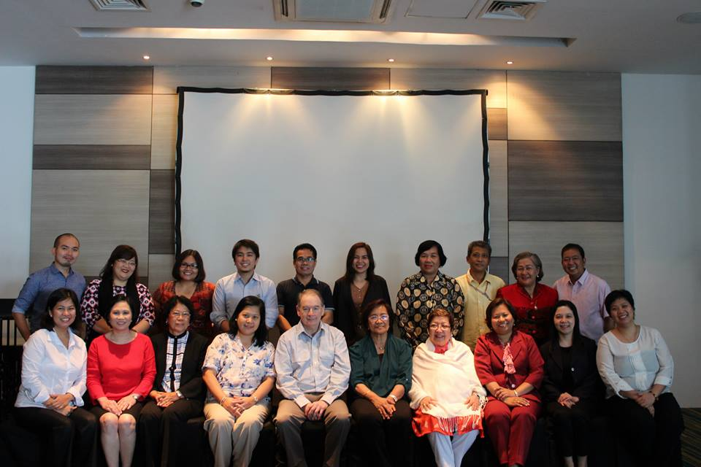
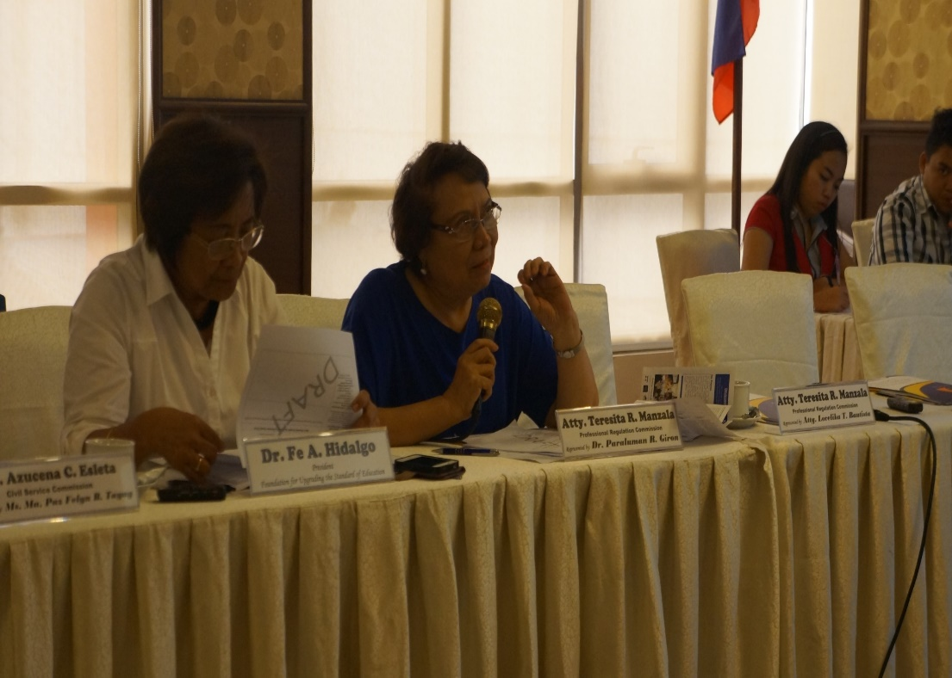
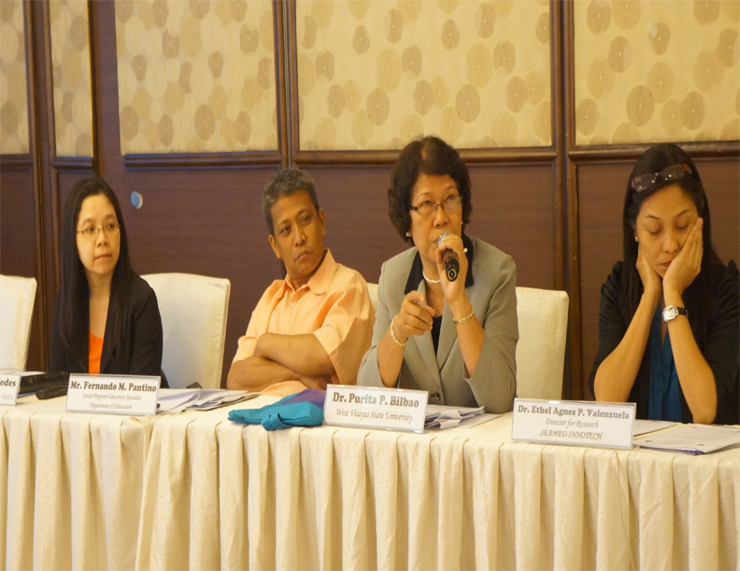
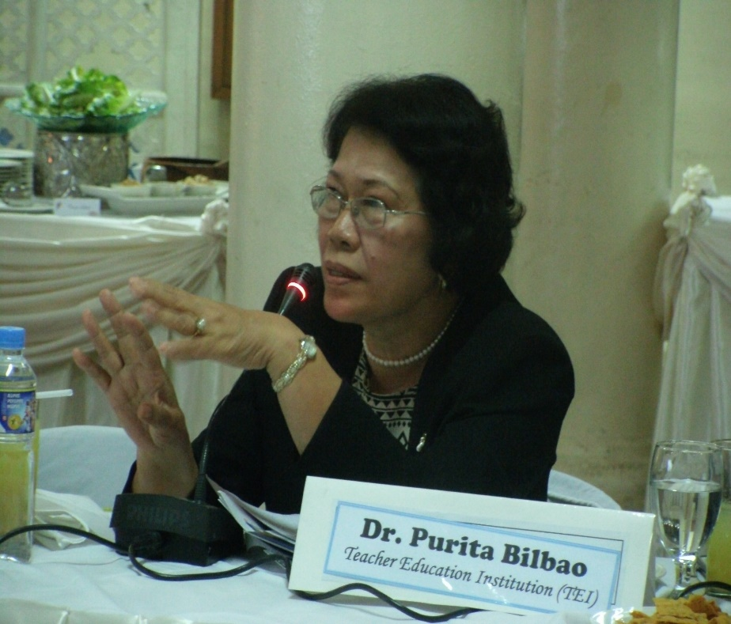
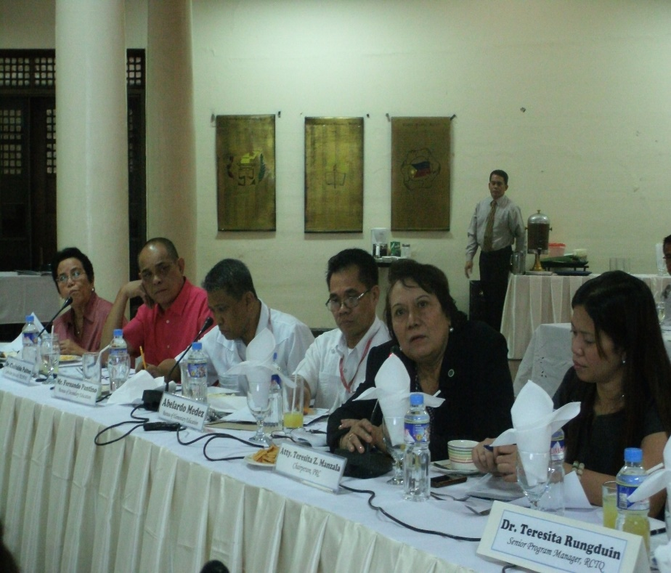
Combined Reference Panel and Technical Working Group Meetings
March 24, 2014
PNU Alumni Hall
May 28, 2014
Manila Ramada Central
May 8, 2015
Hotel H20 Manila
1st
2nd
3rd

Slide 16
Validation Study Methodology
Draft Design Clarification Study
Clarity of meaning of Indicators
Level of difficulty across Career Stages
Validation Studies
(Quantitative and Qualitative)
National Focus Group Workshops
Participants’ perspectives/views/ opinions on the draft Professional Standards for Teachers (Domains, Strands, Indicators and Career stages)
Assessability of Indicators
Evidences of meeting the Indicators

Slide 17
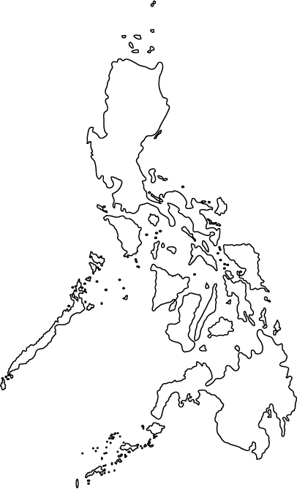
Were key stakeholders involved in the process of development and validation of the PPST?
Over 10,000 pre-and in-service teachers, principals, supervisors, DepEd Regional Directors and other educators across all regions
Government agencies other than DepEd (e.g., PRC, CSC) and NGOs (e.g. PBED, FUSE) were part of the Reference Panel.

Slide 18
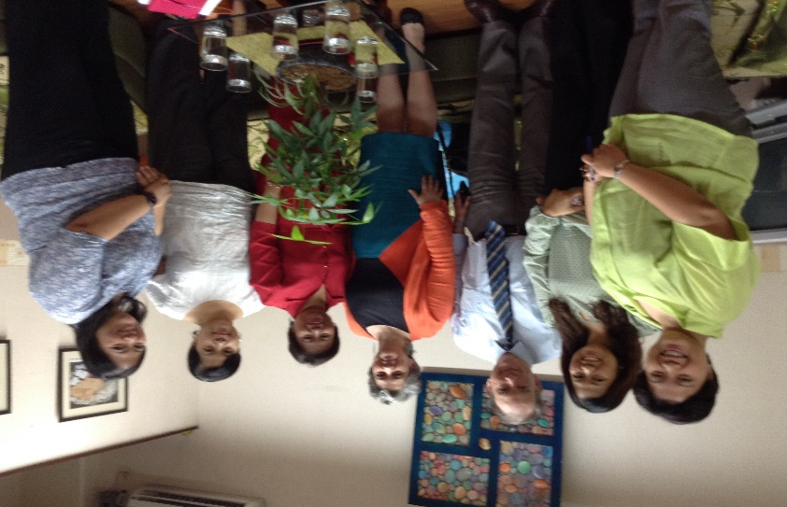
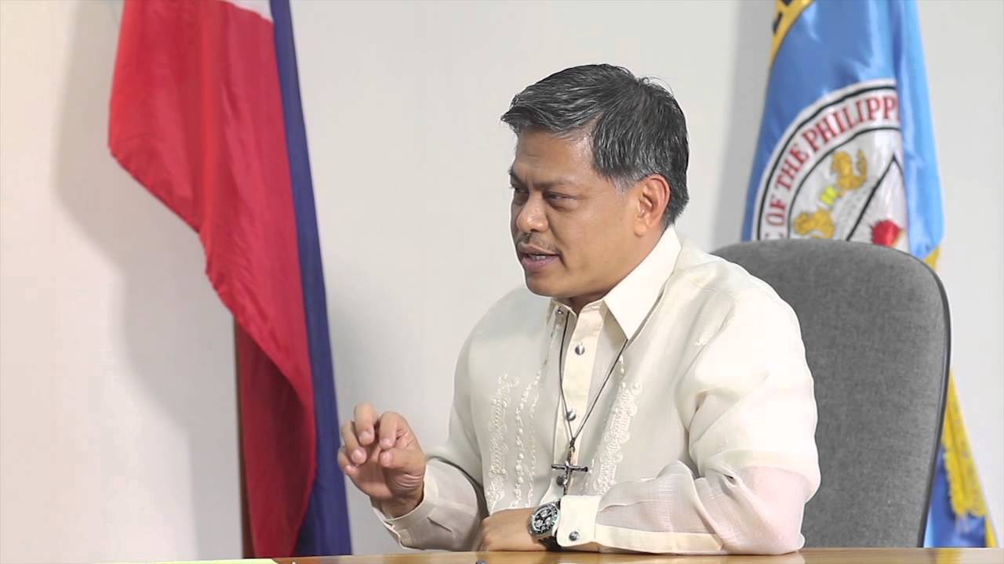
Consultations with DepED
Consultative Meeting
with Usec Dina Ocampo
February 13, 2014; DepEd
Consultative Meeting
with Br. Armin Luistro, Usec Dina Ocampo and Dir Maria Lourdes Pantoja
February 3, 2015; DepEd
Meeting with Directors about Focus Group Workshops
Feb 27 2015; Century Park Hotel
Reference Panel Meetings
March 24, 2014; May 28, 2014; May 8, 2015

Slide 19
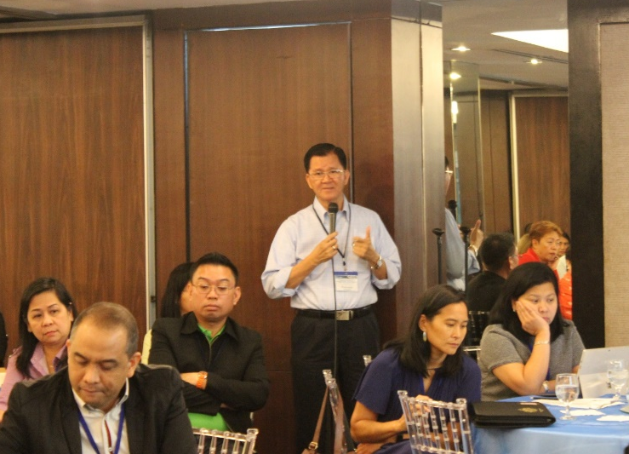
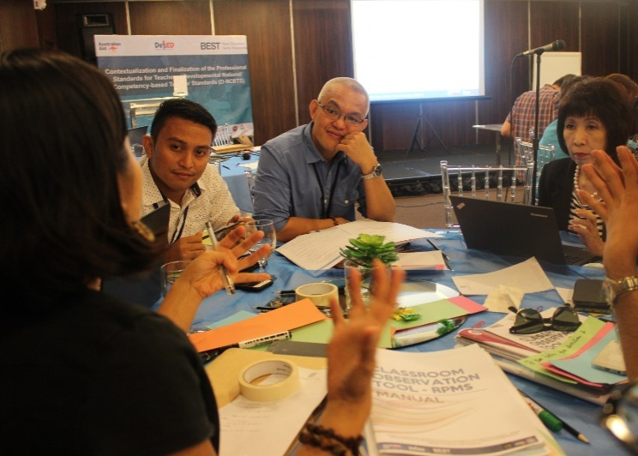
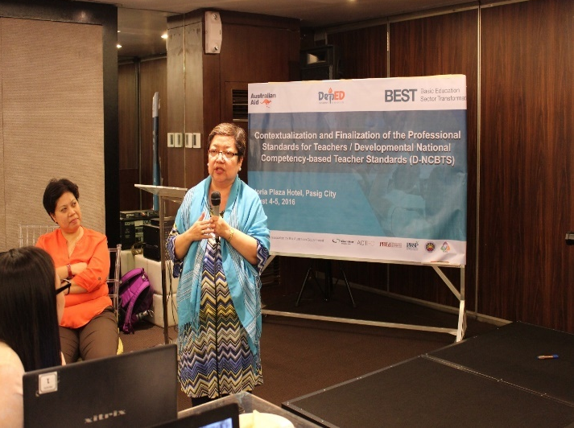
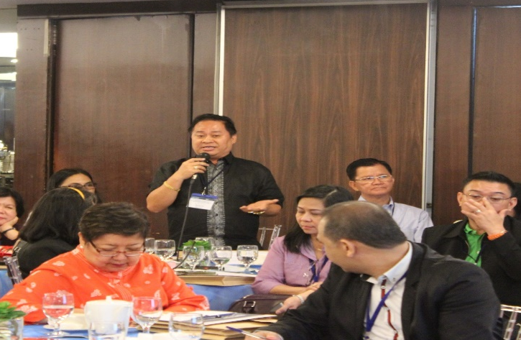
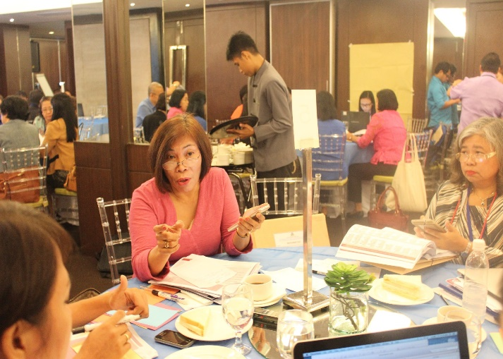
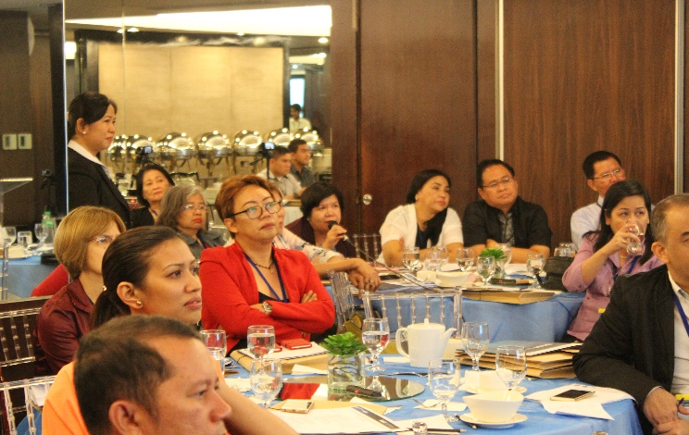

Slide 20
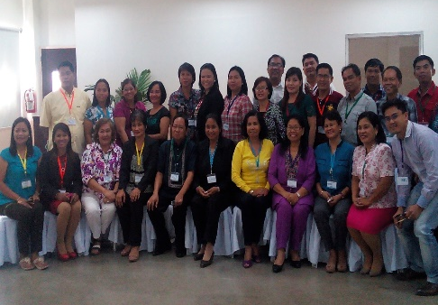
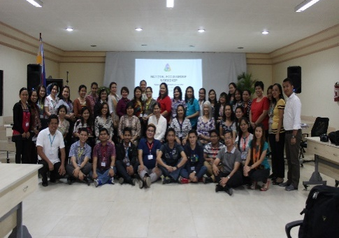
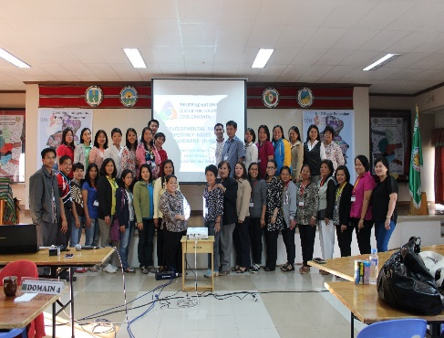
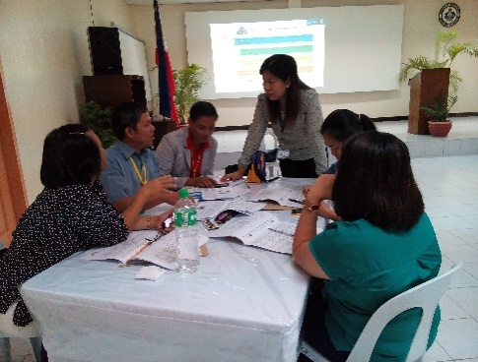
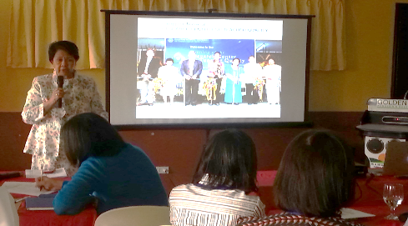
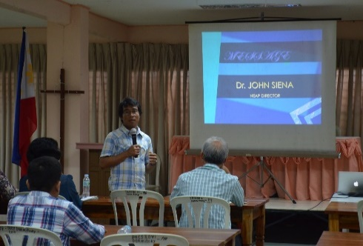
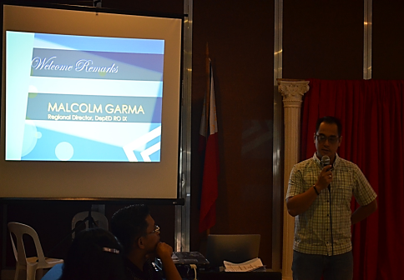
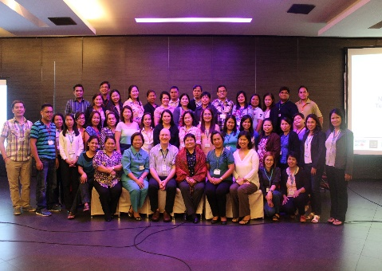
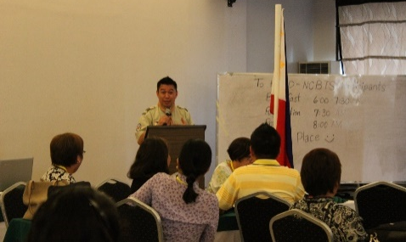
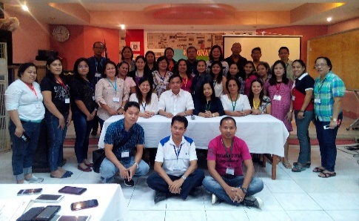
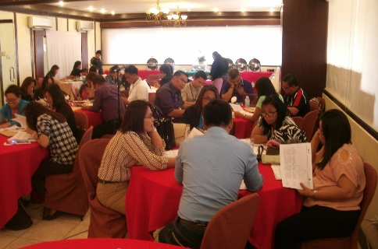
MAR
March 17-18
Focus Group Workshops in Regions II and IV-A
March 19-20
Focus Group Workshops in Regions I, VIII, CAR and ARMM
Region II
Region IV-A
March 23-24
Focus Group Workshop in Region III
Region I
CAR
March 25-26
Focus Group Workshop in Region XIII
Region III
March 26-27
Focus Group Workshop in Region VI
Region VIII
Region VI
March 30-31
Focus Group Workshops in Regions V, VII, IX, X, XI and XII
April 28-29
Focus Group Workshops in Region IV-B and NCR
Region IX
NCR
APR
Region V
National Focus Group Workshops
Region XII
Region X

Slide 21
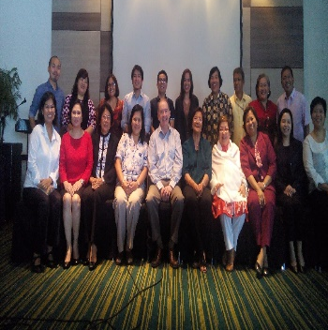
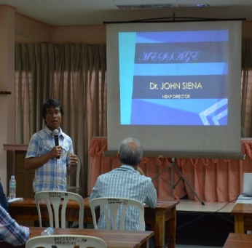
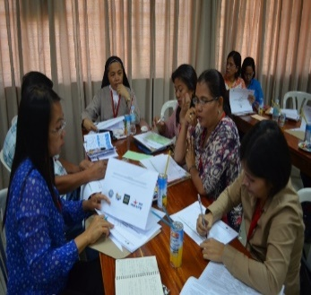
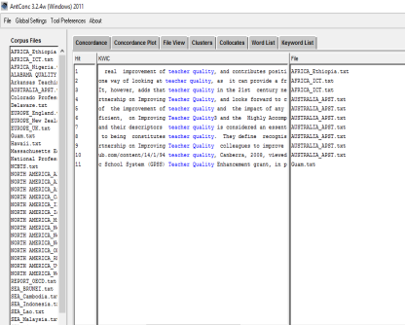
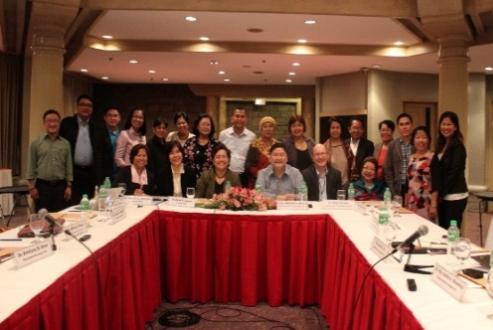
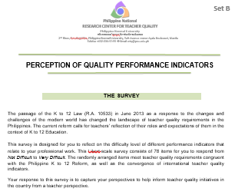
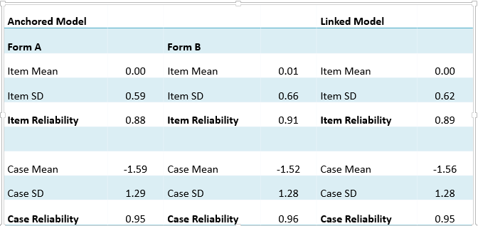
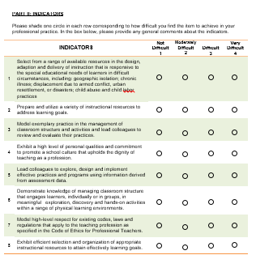
Consultations with DepED, CHED and other key Stakeholders
Lexical and content analyses of Teacher Quality Discourse and International Standards
Feedback from National
Focus Group Workshops
Work on the Philippine Professional Standards for Teachers
Survey of in-service and pre-service teachers, as well as teacher educators)
Psychometric studies of indicators

Slide 22
Validation of the Philippine Professional Standards for Teachers (PPST)
captured the voice of the profession
aligned the draft standards framework with “the expectations of teachers”
developed each career stage as a viable single entity
ensured there was a clear developmental pathway linking one Career Stage to the next.

Slide 23
Philippine Professional Standards for Teachers as the New Framework for
Teacher Quality and Teacher Development

Slide 24
K to 12
(2013)
Philippine Professional Standards for Teachers
21st Century
Skills
National Competency-based Teacher Standards (NCBTS)
Philippine Qualifications Framework
ASEAN Integration/
Internationalization

Slide 25
Teacher Professional Development Framework
Career Path
Stage 1
(Beginning)
Stage 2
(Proficient)
Stage 3
(Highly Proficient)
Stage 4
(Distinguished)
Recruitment
and Hiring
Learning Action Cells
Teacher Induction
Program
1 → 2
Teacher Entry
Requirement
Rewards,
Compensation (?)
Teacher Certification at Career
Stage 2, 3, 4 (?)
Teacher Education
Classroom Observation Tool & Self-Assessment Tool
Targeted Professional Development and Teacher Training

Slide 26
Other Important Features of the PPST

Slide 27
The PPST captures teacher quality requirements in the K to 12.
Among others, it gives a focus on:
mother tongue to facilitate teaching and learning;
learners in difficult circumstances;
strategies for promoting literacy and numeracy;
positive use of ICT; and
classroom communication strategies.

Slide 28
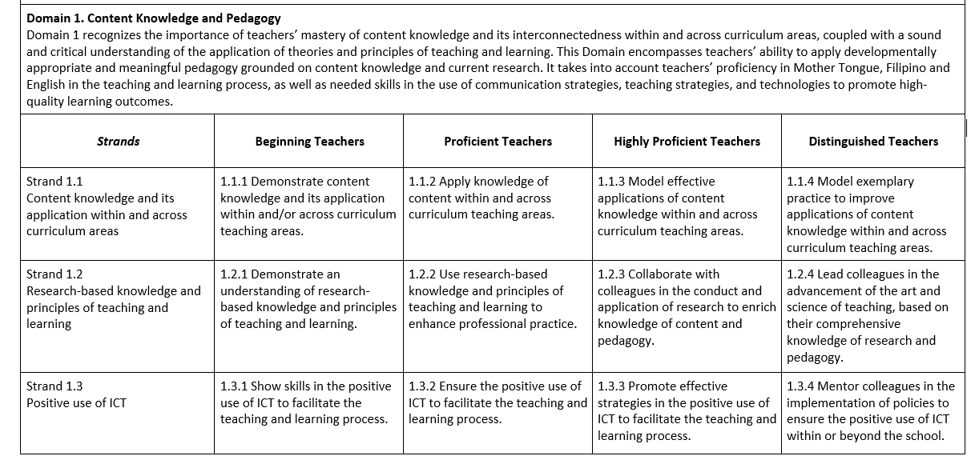
PPST Booklet, p113
Domains “distinctive spheres of the teaching-learning process”
4 Career Stages: Descriptions of developmental practice
Strands “more specific dimensions of positive teacher practices”
Indicators per career stage
”concrete, observable, measure teacher practices”

Slide 29
Domains
Philippine Professional Standards for Teachers
Central to the K to 12 Reform and places, at the beginning, the importance of teachers knowing their content and knowing how to teach it.
1 Content Knowledge and Pedagogy
2 Learning Environment
3 Diversity of Learners
4 Curriculum and Planning
5 Assessment and Reporting
6 Community Linkages and Professional Engagement
7 Personal Growth and Professional Development

Slide 30
Strand 1.1
Content knowledge and its application within and across curriculum areas
Strand 1.2
Research-based knowledge and principles of teaching and learning
Domain 1
Content Knowledge
and Pedagogy
Strand 1.3
Positive use of ICT
Strand 1.4
Strategies for promoting literacy and numeracy
Strand 1.5
Strategies for developing critical and creative thinking, as well as other
higher-order thinking skills
Strand 1.6
Mother Tongue, Filipino and English in teaching and learning
Strand 1.7
Classroom communication strategies

Slide 31
Strand 2.1
Learner safety and security
Strand 2.2
Fair learning environment
Strand 2.3
Management of classroom structure and activities
Domain 2
Learning
Environment
Strand 2.4
Support for learner participation
Strand 2.5
Promotion of purposive learning
Strand 2.6
Management of learner behavior

Slide 32
Strand 3.1
Learners’ gender, needs, strengths, interests and experiences
Strand 3.2
Learners’ linguistic, cultural, socio-economic and religious backgrounds
Domain 3
Diversity of Learners
Strand 3.3
Learners with disabilities, giftedness and talents
Strand 3.4
Learners in difficult circumstances
Strand3.5
Learners from indigenous groups

Slide 33
Strand 4.1
Planning and management of teaching and learning process
Strand 4.2
Learning outcomes aligned with learning competencies
Domain 4
Curriculum and
Planning
Strand 4.3
Relevance and responsiveness of learning programs
Strand 4.4
Professional collaboration to enrich teaching practice
Strand4.5
Teaching and learning resources including ICT

Slide 34
Strand 5.1
Design, selection, organization and utilization of assessment strategies
Strand 5.2
Monitoring and evaluation of learner progress and achievement
Domain 5
Assessment
and
Reporting
Strand 5.3
Feedback to improve learning
Strand 5.4
Communication of learner needs, progress and achievement to key stakeholders
Strand5.5
Use of assessment data to enhance teaching and learning practices and programs

Slide 35
Strand6.1
Establishment of learning environments that are responsive to community context
Domain 6
Community
Linkages and Professional
Engagement
Strand 6.2
Engagement of parents and the wider school community in the educative process
Strand 6.3
Professional ethics
Strand 6.4
School policies and procedures

Slide 36
Strand7.1
Philosophy of teaching
Strand 7.2
Dignity of teaching as a profession
Domain 7
Personal Growth and Professional
Development
Strand 7.3
Professional links with colleagues
Strand 7.4
Professional reflection and learning to improve practice
Strand7.5
Professional development goals

Slide 37
Use of Mother Tongue, Filipino and English in teaching and learning
Knowledge of research
Strategies for promoting literacy and numeracy
Strategies for developing critical and creative thinking skills
Know what to teach and how to teach it
Engage in
professional
reflection and assume responsibility for personal
professional
learning
Classroom communication strategies
Maintain a learning-focused environment
Learners’ linguistic, cultural, socio-economic and religious backgrounds
What qualities are expected of teachers based on these Domains of the PPST?
Establish community relationships and uphold professional ethics
Respond to learner diversity
Learners in difficult circumstances
Use a variety of assessment tools to inform and enhance the teaching and learning process
Plan and design effective instruction
Learners from Indigenous Groups

Slide 38
What are the four Career Stages of the PPST?
B
P
HP
D
Beginning
Teachers
Proficient
Teachers
Highly
Proficient
Teachers
Distinguished
Teachers
are those who have gained the qualifications recognized for entry into the teaching profession.
are supported to reach Career Stage 2 within two to three years.
professionally independent in the application of skills vital to the teaching and learning process
display skills in planning, implementing and managing learning programs
consistently display a high level of performance in their teaching practice
provide support and mentoring to colleagues in their professional development
embody the highest standard for teaching grounded in global best practice
recognized as educators, leaders, contributors to the profession

Slide 39
Career Stages
PAUSE.
What do you think of the Career Stages?
Can you identify teachers in your school/district/division/region that fit in a particular career stage?

Slide 40
Teacher professional growth can be represented by:
It is valuable to have sign posts along the way to help identify progress.
Beginning
training
Exemplary practice
Teacher quality Stages are developmental in nature and exist on a quality continuum.
This is about teachers, not leadership roles such as Principals and Supervisors.

Slide 41
Beginning
Proficient
Highly Proficient
Distinguished
1
2
3
4
5
6
7
8
9
10
11
12
13
14
15
16
17
18
19
20
21
22
23
24
25
26
27
28
29
30
31
32
33
34
35
36
37
Positive use of ICT
Positive use of ICT
CAREER STAGE CONTINUUM
Teaching and learning resources including ICT
Professional reflection and learning to improve practice
Professional reflection and learning to improve practice

Slide 42
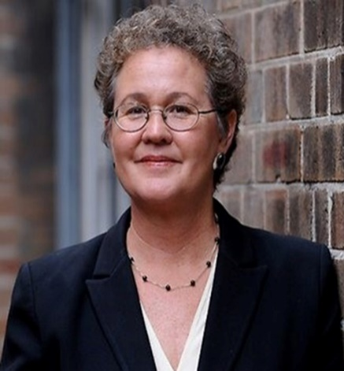
Why are Career Stages important?
The description of standards
at different career stages
provides “a framework for the
teacher development continuum.”
(OECD,2005)
Teacher evaluation should be based on professional teaching standards
and should be sophisticated enough
to assess teaching quality across
the continuum of development
from novice to expert teacher. (Darling-Hammond in Strauss, 2012)

Slide 43
Implications of Career Stages
Career stage 1 offers:
realistic requirements of teachers in training.
TEIs what they need to guide the design of teacher education programs and judge pre-service teacher quality
Career stage 2:
is for teachers of good quality in school and is what teachers need to enjoy success and a sense of genuine professionalism
allows a focus for school-based induction for beginning teachers.

Slide 44
Implications of Career Stages
Career stage 3 allows a focus on:
high-quality teaching
mentoring which is a defining characteristic of a profession where established practitioners exercise responsibility for the development of their peers
Career stage 4:
shows exemplary teaching
is recognised as a leader and mentor in teaching and curriculum.

Slide 45
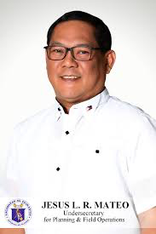
Implications of Career Stages from
Manila Bulletin 21/10/17
This policy (PPST) is also based on the international standards for teachers and will be used to tell the TEIs – through the Commission on Higher Education (CHED) – if they can look into the pre-service curriculum to ensure that what is being taught to future teachers would be aligned with what the system needs.”
Undersecretary for Planning and Field Operations Jesus Mateo

Slide 46
Developmental Career stages
can help teachers
guide professional development that provides achievable quality targets, focused advice and feedback on performance
achieve realistic outcomes of development of practical quality in teaching
The FOCUS for the NEXT FEW YEARS WILL be on improved PROFESSIONAL LEARNING

Slide 47
Teacher Assessment based on the Philippine Professional Standards for Teachers

Slide 48
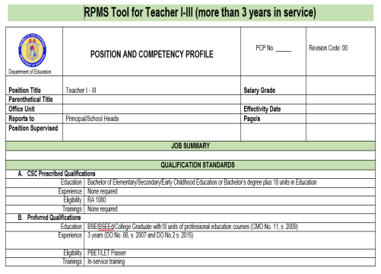
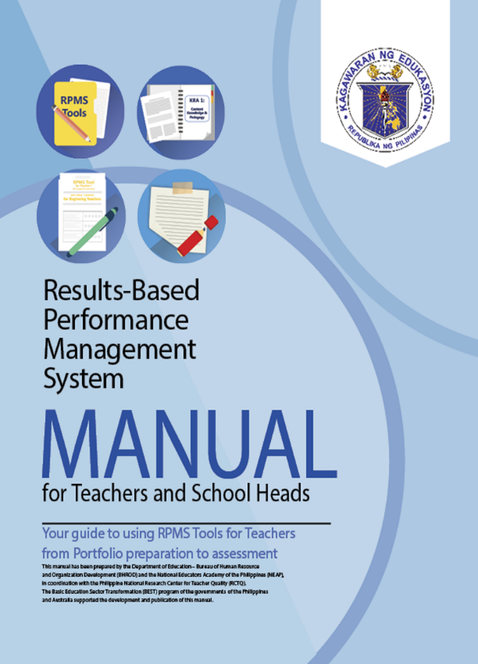
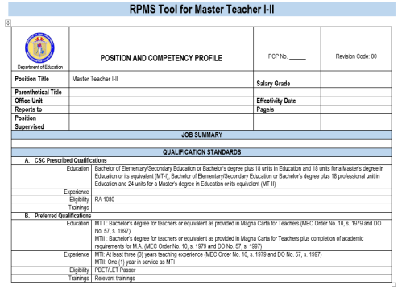
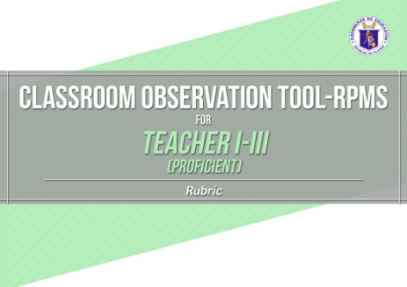
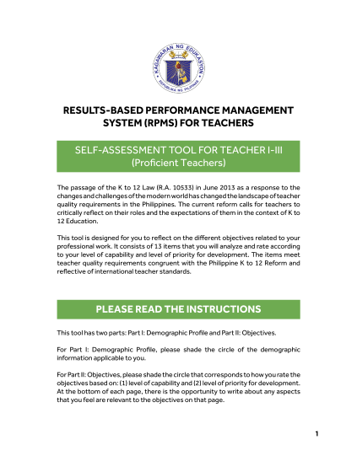
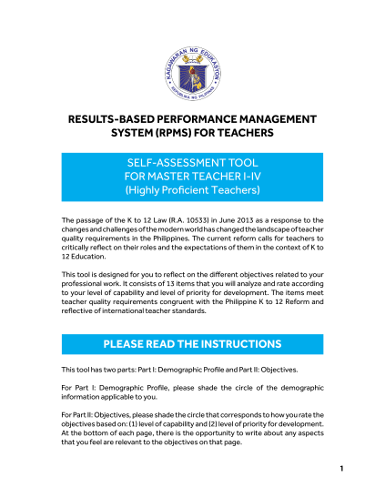
PPST-based Tools
Classroom Observation
Tools
RPMS Tools for Teachers
Self-Assessment Tools

Slide 49
Three things that matter most in top school systems (McKinsey, 2007)
Getting the right people to become teachers
Developing
them into
effective
instructors
Ensuring that
the system is able
to deliver the best possible instruction
for every child

Slide 50
Questions?

Slide 51
Developed through the Philippine National Research Center for Teacher Quality (RCTQ)

Slide 52
Presentation slides
Dr. Gina O. Gonong
Director, RCTQ
Dr. John Pegg
Director, UNE-SiMERR, Australia
Michael Wilson I. Rosero
Senior Research Officer, RCTQ

