Slide 3
Welcome to Module 2

Slide 4
I am Teacher Mike
I am Teacher Mike and with me is Teacher Jen.
We will introduce you to a range of teaching strategies that promote literacy and numeracy and how becoming literate and numerate expand the learners’ opportunities to access wider understandings.

Slide 5
In this module, we will focus on:
STRAND: Strategies for promoting
literacy and numeracy
INDICATOR: 1.4.2 Use a range of
teaching strategies that
enhance learner achivement
in literacy and numeracy skills

Slide 6
Objectives:
At the end of the session, participants are expected to:
be acquainted with literacy and numeracy concepts;
reflect on current practice in using a range of teaching strategies that enhance learner achievement in literacy and numeracy skills; and
develop ways to further enchance knowledge, skill and attitude in Indicator 1.4.2.
Notes:
Participants in thie orientation are SDSs, ASDSs, supervisors- the ones who will support teachers.

Slide 7
Image retrieved from
http://cdn.playbuzz.com/cdn/1d103ffe-5cb6-4df7-8261-251732fd2acb/b331980a-a42d-4782-a9d2-c97708e48914_560_420.jpg

Slide 8
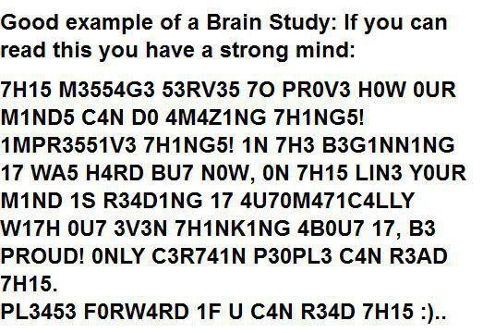
Image retrieved from http://icantseeyou.typepad.com/.a/6a00e5504cf4f78833016761de0608970b-pi

Slide 9
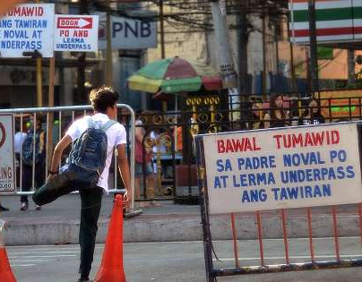
Image retrieved from https://img-s-msn-com.akamaized.net/tenant/amp/entityid/AAyKJ66.img?h=315&w=600&m=6&q=60&o=t&l=f&f=jpg
What can you say about the picture?
How would you relate this to literacy?

Slide 10
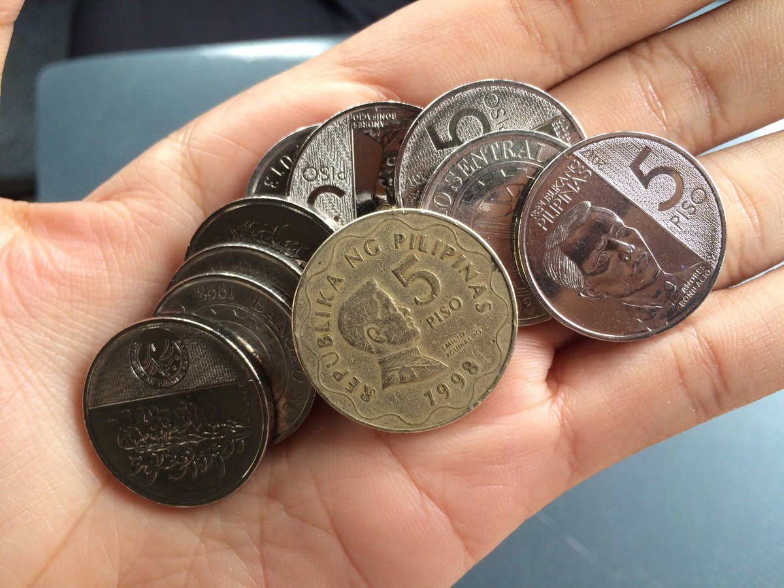
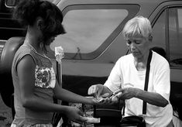
How do you think the concept of numeracy relate to ordinary people?
Images retrieved from https://pbs.twimg.com/media/DVeiiwtVQAALSkX.jpg and https://i.pinimg.com/236x/19/9a/2d/199a2d64bbab56a0199485a9ca838b52.jpg

Slide 11
How would you define now literacy and numeracy?

Slide 12
Now, let me introduce you Module 2. You will find there an overview of the indicator, its key concepts, suggestions for improvement, and illustrations of practice.
Are you ready?
Cellphones away.
READ your modules for 20 minutes.
Notes:
Go to next slide for the Guide Questions

Slide 13
Guide Questions:
1. What concepts did you learn from the module?
2. What are the different illustrations of practice (IP)?
3. What are the different principles under each IP?
4. What IP do you find to be most helpful for teachers?
5. What other possible examples can you provide that are not writtten in the module?
6. If you were to teach this module to teachers that need help in Indicator 1.4.2, how would you do it? (Think in terms of your current position as Supervisor, Principal or MT)

Slide 14
INDIVIDUAL READING TIME
Notes:
Flash the guide questions in the previous slide. Give them 15 minutes to answer the questions.

Slide 15
Answering the Guide Questions
Sharing Answers in a Small Group
15 minutes
Sharing Answers in the Big Group
(without repeating what earlier groups have discussed)

Slide 16
CHALLENGE:
Think as a teacher.
As teachers of literacy and numeracy across the curriculum, we should provide our learners a range of different contexts in which they can use these skills. We all have the responsibility to promote these skills in our classroom.
Notes:
Then the responsibility for literacy must not just lie with the language teachers, who admittedly are at the center of the task, but with teachers of all subjects who have the responsibility of supporting children in developing their literacy skills.
In all levels and curriculum areas, we should explore the possibilities of extending and complementing numeracy and literacy.

Slide 17
Reinforcement Activity

Slide 18
CHALLENGE ACCEPTED!
With your group, think of strategies on how you can teach literacy and numeracy skills in your assigned subjects.
Mechanics:
Discuss / plan for 10 minutes.
Everyone stops so we can give all our attention to the presenters.
3 to 5 minutes per group to present.
Notes:
There are an endless number of engaging, effective strategies to get learners to think about, write about, read about, and talk about the content you teach.

Slide 19
CHALLENGE ACCEPTED!
Group 1: Science
Group 2: Araling Panlipunan
Group 3: ICT
Group 4: TLE / EPP / Home Economics
Group 5: ESP / Values
Notes:
However, are we affording learners enough time daily to practice crucial communication skills?
All teachers have a responsibility for promoting numeracy subjects.

Slide 20
Fellow Teacher, literacy is not just about learning to read and write. It is necessary in order to learn any subject at school. Similarly, numeracy is more than counting numbers. Both skills are at an interplay in the holistic performance of our learners. We should give our children quality instruction so that they can have the best chances to succeed in life.

Slide 21
“According to studies, in a meaningful and fun-filled context, children can acquire skills without the pressure and fear of failure in quite the same way as they might feel in a more structured learning environment.”

Slide 22
Which part/s of this module help me become better equipped with Indicator 1.4.2?
Given the examples in the module, what can I do to help my teachers better understand Indicator 1.4.2?

Slide 23
“The ultimate goal of literacy instruction is to build a learner’s comprehension, writing skills, and overall skills in communication.”

Slide 24
“NUMERACY. Developing learners ability to understand and use mathematical knowledge for calculating, problem solving, and interpreting information in order to arrive at educated and well-informed decisions.”

Slide 25
After exploring this module, we hope you have a better appreciation of the indicator.

Slide 26
Thank you! ☺

