Slide 1
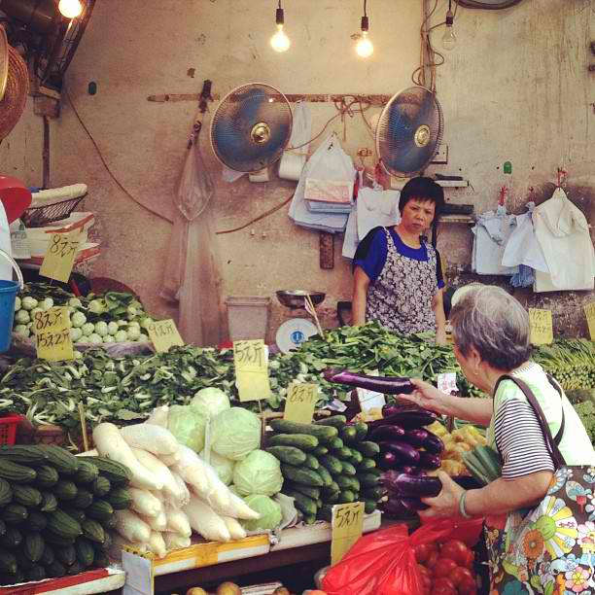
Describe the situation shown in the picture

Slide 2
Activity
Role Playing: The class is divided into 5 groups
Each group is given a certain situation
1. the costumer will buy the right quantity
2. the costumer will Buy the Right Quality
    3. the costumer will Buy at the Right Price
    4. the costumer will Buy from the Right Source.
    5. the costumer will Buy at the Right Time

Slide 3
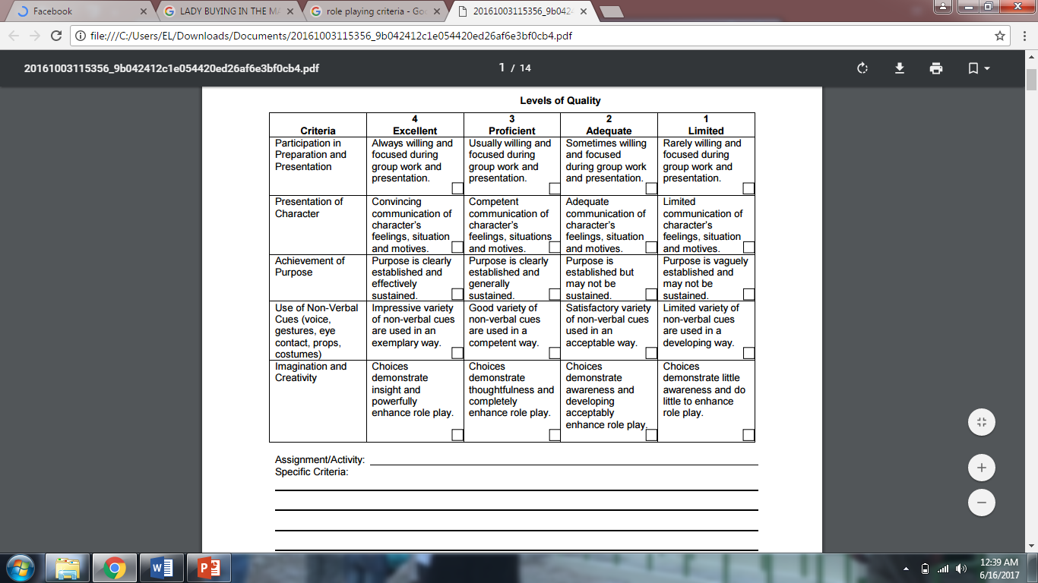
Rubrics in Role playing

Slide 4
EFFECTIVE PURCHASING STEPS AND PROCEDURES

Slide 5
Purchasing of food and supplies
one of the most important activities in home and in any food establishment.
It is defined as the process of buying the right amount of food at the right time, from the right place and from the right source
It is a complex and dynamic process with the goal of securing the pre-established standards for quantity and with economical price to meet the needs of the food service operation.

Slide 6
The main objectives of an effective purchasing program are to:
Buy the product that is best suited for the menu
Buy the proper quantity of the item.
Pay the proper quantity of the item.
Deal with only reputable and dependable suppliers.

Slide 7
Purchasing techniques include:
comparative shopping,
evaluation of new products,
wise judgment in timing large purchases of seasonal items and selection of the most efficient supplier.

Slide 8
The following are essential guidelines that you should remember for effective purchasing activity:
Buy the Right Quantity.
Buy quantities based on the operation’s needs and par stocks to avoid storage cost, wastage, pilferage, and too much money tied up in the storeroom.
Buy the Right Quality
The right quality is not always the best qualities. The right quality is that determined by the needs of operations and communicated through food specifications. This is what must be strictly followed and monitored.
Buy at the Right Price
Canvass, canvass, and canvass. Do not be satisfied with just one or two suppliers. Go out of your way to find establishments with good prices.

Slide 9
The following are essential guidelines that you should remember for effective purchasing activity:
Buy from the Right Source.
Be sure that your supplier is reputable and reliable. Their products must be safe and come from good sources. They must also deliver what they promise within the given period of time.
Buy at the Right Time.
Observe the needs of the production area carefully. Schedule regular purchases based on the needs. Avoid emergency purchases as this costs money. Consider ingredients in season and delivery lead-time of suppliers. Practice “just-in-time” whenever practical

Slide 10
Effective Purchasing Steps and Procedures
Identify needs by planning new reviewing existing menus for each business unit of the food service organization
Select and negotiate with vendors
Determine standards of quality for each food item and write specifications.
Conduct market research on potential vendors product availability
Figure 1: The basic flow of purchasing activities
Estimate quantities needed.
Develop purchase orders.
Calculate desired inventory or stock levels for each item.
Identify the amounts to purchase by subtracting stock levels from desired quantities.

Slide 11
Application: Arrange the effective purchasing steps and procedures chronologically
Estimate quantities needed.
Conduct market research on potential vendors product availability
Identify the amounts to purchase by subtracting stock levels from desired quantities.
Develop purchase orders.
Calculate desired inventory or stock levels for each item.
Determine standards of quality for each food item and write specifications.
Identify needs by planning new reviewing existing menus for each business unit of the food service organization
Select and negotiate with vendors

Slide 12
Assessment:
Pencil and Paper test:
1. Enumerate at least 3 main objectives of an effective purchasing program.
2. What is purchasing? (5 pts.)
4. Enumerate the following guidelines that you should remember for effective purchasing activity.

Slide 13
Assignment
Interview atleast three owner managers or the chief cook.
Ask their considerations in preparing the recipe, its quantity and determine the price of their menu.

Slide 14
“Life has its woes so learn to be on your toes, be alert”

