Slide 1
Tell the ingredients and procedure of the recipes

Slide 2
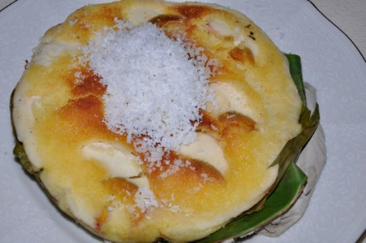

Slide 3
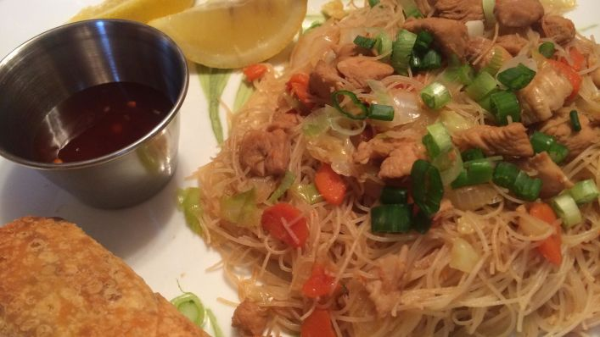

Slide 4
