Slide 1
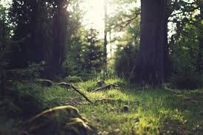
Photosynthesis
MARIA KAREN B. CASIL
PINAMUNGAJAN NHS

Slide 2
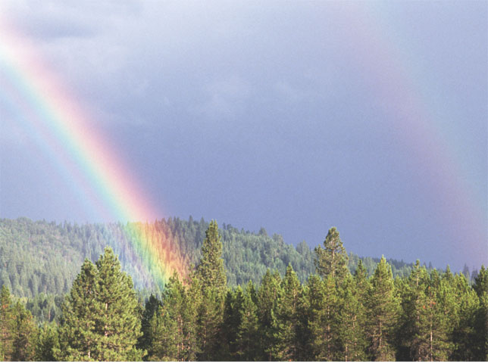
Photosynthesis
----→Is the process that converts solar energy into chemical energy

Slide 3
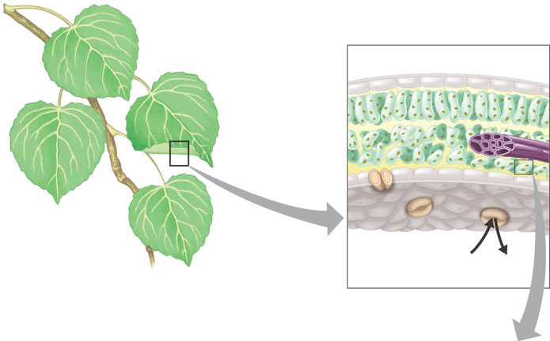
The leaves of plants Are the major sites of photosynthesis
Leaf cross section
Vein
Mesophyll
Stomata
CO₂
O₂

Slide 4
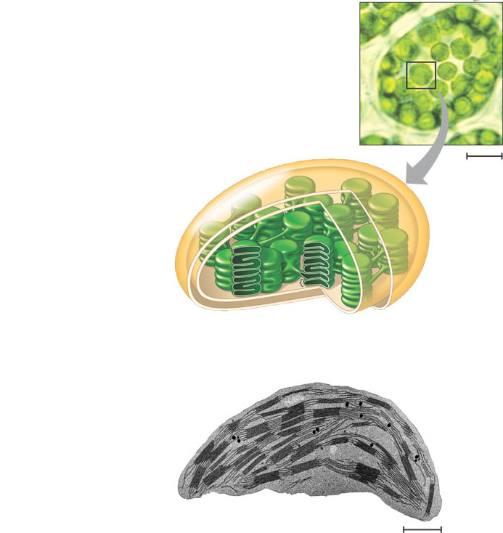
Chloroplasts Are the organelles in which photosynthesis occurs
Mesophyll
Chloroplast
5 µm
Outer
membrane
Thylakoid
Thylakoid
space
Intermembrane
space
Stroma
Granum
Inner
membrane
1 µm

Slide 5
Photosynthesis is summarized as
6 CO₂ + 12 H₂O + Light energy → C₆H₁₂O₆ + 6 O₂ + 6 H₂ O

Slide 6
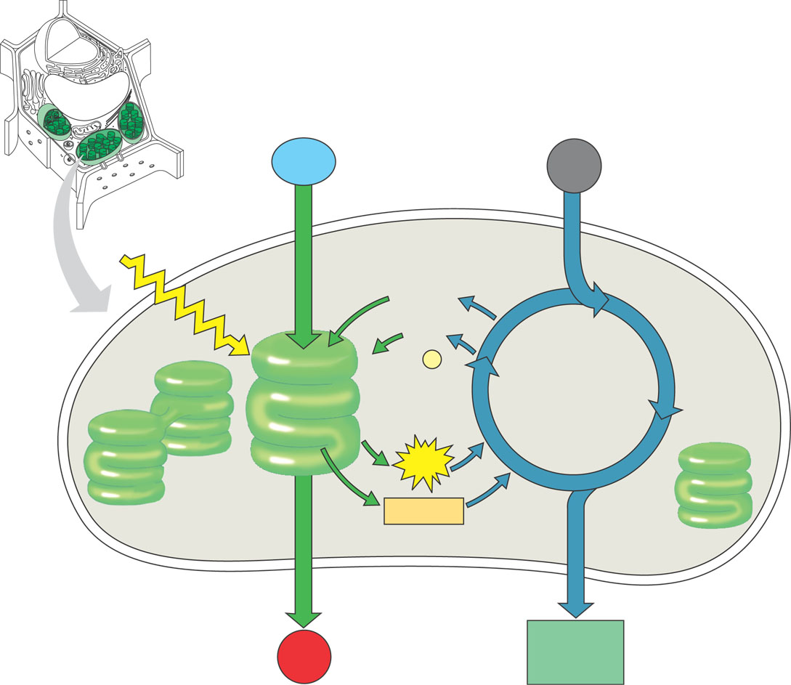
An overview of photosynthesis
H₂O
CO₂
Light
NADP ⁺
ADP
+ P
LIGHT REACTIONS
CALVIN
CYCLE
ATP
NADPH
Chloroplast
O₂
[CH₂O]
(sugar)

Slide 7
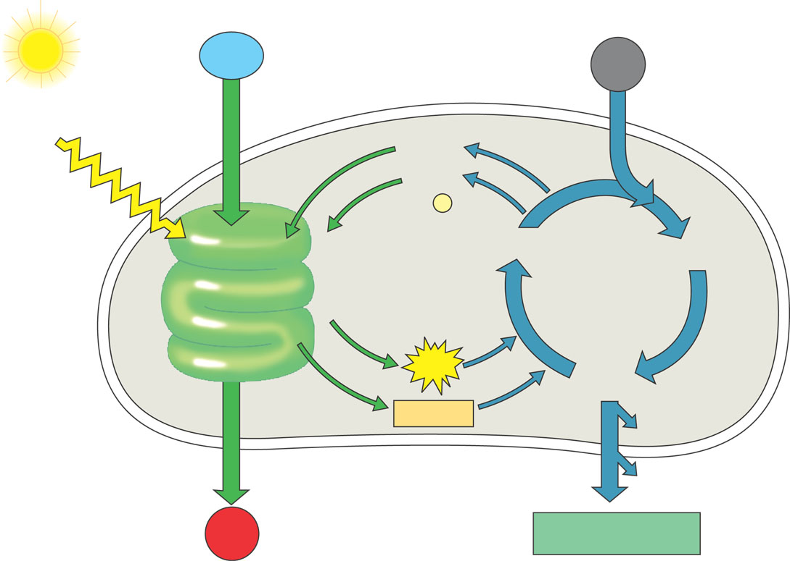
Light Is a form of electromagnetic energy, which travels in waves
Pigments
Are substances that absorb visible light
Light reaction
Calvin cycle
H₂O
CO₂
Light
NADP⁺
ADP
+ P ₁
Photosystem II
Electron transport chain
Photosystem I
RuBP
3-Phosphoglycerate
ATP
G3P
NADPH
Starch
(storage)
Amino acids
Fatty acids
Chloroplast
O₂
Sucrose (export)
Light reactions:
• Are carried out by molecules in the
thylakoid membranes
• Convert light energy to the chemical
energy of ATP and NADPH
• Split H₂O and release O₂ to the
atmosphere
Calvin cycle reactions:
• Take place in the stroma
• Use ATP and NADPH to convert
CO₂ to the sugar G3P
• Return ADP, inorganic phosphate, and NADP+ to the light reactions

