Slide 1
Walkthrough of the
Mark Anthony P. Idang
SDO Laguna, Region IV-A CALABARZON

Slide 2
Objectives Main: Understand and appreciate Module 9
Identify key concepts in Module 9
Read the module and respond to questions
Express reflections on the uses of the modules for other teachers
Practice skills in determining appropriate TLRs.

Slide 3
Let’s have an activity…

Slide 4
Activity 1. Paint me a Picture
Each district should have two (2) representatives.
The representatives need to have someone who will draw and someone who will tell instructions.
An activity card will be given to the one who will give instructions while the other one follows.
The partner is given only two attempts to perform the activity.
Present the output in the group.
Notes:
NOTE TO FACILITATOR:
1ST ATTEMPT: Only the one who will give instructions is allowed to talk.
2ND ATTEMPT: Both representatives may talk to clarify things.

Slide 5
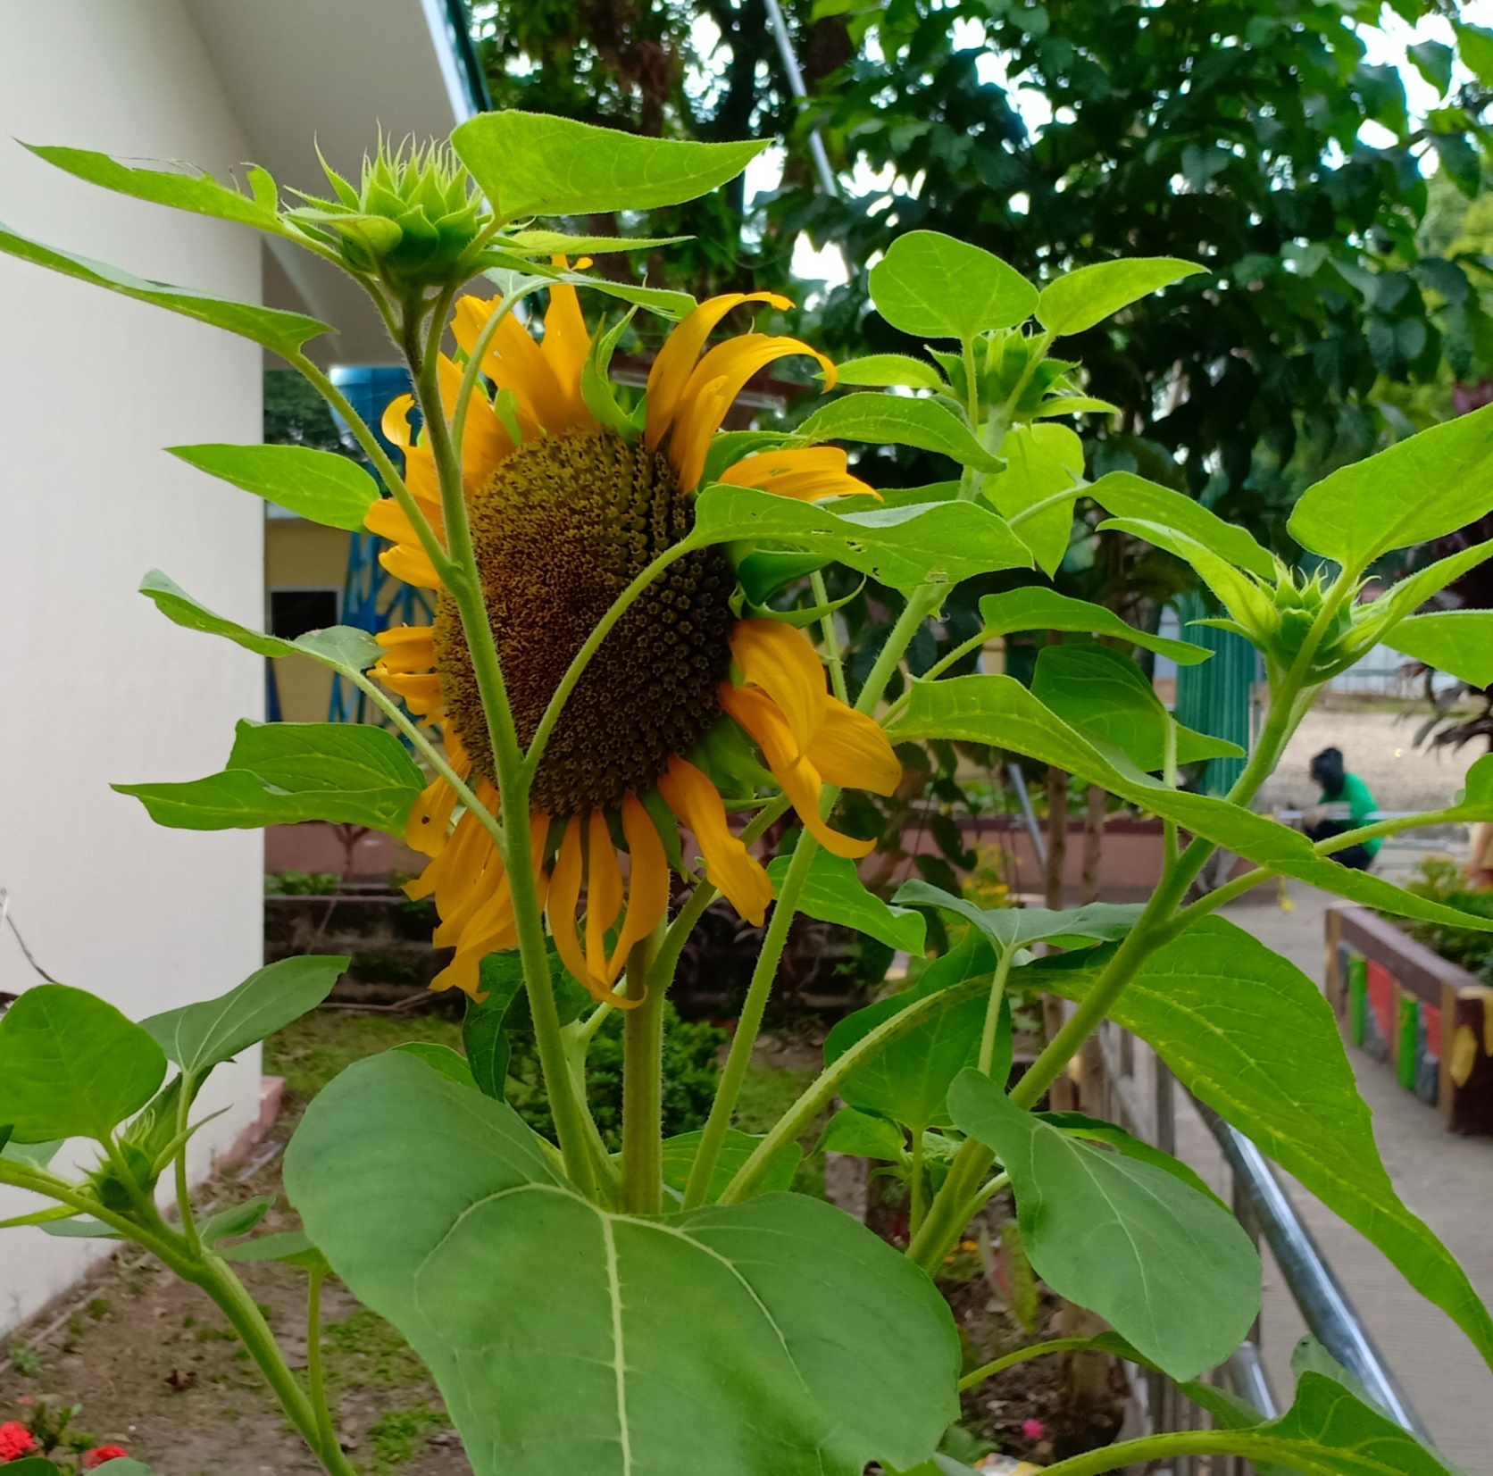
Notes:
NOTE TO FACILITATOR:
1ST ATTEMPT: Only the one who will give instructions is allowed to talk.
2ND ATTEMPT: Both representatives may talk to clarify things.

Slide 7
How will you describe your drawing?
How effective is the one giving instructions? How about the one doing the drawing?
What made the activity more effective? Less effective?
What are your realizations in the activity?
Notes:
NOTE TO FACILITATOR:
The activity aims to generate and solicit ideas from the participants the importance of addressing the goal through properly coursed activity.

Slide 8
Notes:
Ask the participants about their insights of the quotation.

Slide 10
Have a small group discussion for 10 minutes then share your discussion in the big group for another 5 minutes.

Slide 11
Pre-reading Guide Questions
What indicator is being addressed by the module?
Were the initial activities or parts of the module give the overview of what to expect for the entire document?
What samples or illustrations of practice do you find helpful?
Can you give other examples of practice that are not presented in the module which can supplement the ones written?
What significance can we get from the module?

Slide 12
Reading Proper
(15 minutes)

Slide 13
Post Reading. Discuss your answers to the following questions in 10 minutes in small group and be ready to share your consolidated responses in the big group for another 5 minutes.
What indicator is being addressed by the module?
Were the initial activities or parts of the module give the overview of what to expect for the entire document?
What samples or illustrations of practice do you find helpful?
Can you give other examples of practice that are not presented in the module which can supplement the ones written?
What significance can we get from the module?

Slide 15
Let’s Practice

Slide 20
Let’s plan

Slide 21
Activity 2. Let’s Plan It
In your respective groups, make a plan on how this module can be used by teachers in:
Personal Reflection
School Learning Action Cell Session/District LAC Session
Each group is given 5 minutes to present their answers.

Slide 22
Using the Professional Development found in the last part of the module, what plan of action can a teacher do to improve his practice?

Slide 23
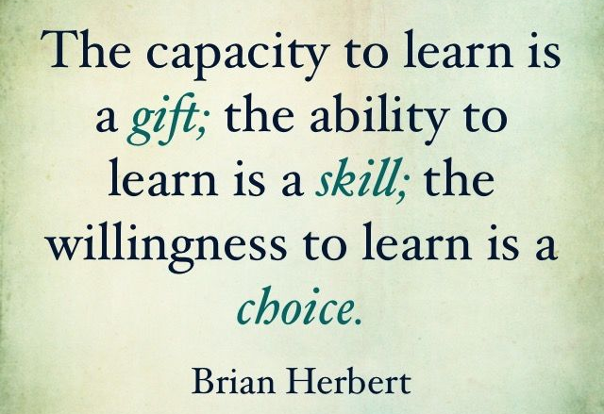

Slide 24
Mark Anthony P. Idang
SDO Laguna, Region IV-A CALABARZON
mark.idang@deped.gov.ph

