Slide 1
SESSION 7
INTRODUCTION TO RPMS TOOLS
RCTQ

Slide 2
Objective:
This session aims to introduce to the participants the RPMS tools for teachers.

Slide 3
Activity 1 (5 mins)
Instructions:
In a blank sheet of paper, draw a big circle.
With eyes closed, draw the parts of your face.

Slide 4
Were you able to put the parts of your face in the right place? Why? Why not?
Notes:
After the activity, ask the participants the processing questions.
USE METACARDS FOR NO. 5

Slide 5
2. If given the chance to draw the parts of your face again, how will you do it? Explain.
Notes:
After the activity, ask the participants the processing questions.
USE METACARDS FOR NO. 5

Slide 6
3. How will you compare this activity to our current practice in assessing the quality of our teachers’ performance?
Notes:
After the activity, ask the participants the processing questions.
USE METACARDS FOR NO. 5

Slide 7
4. If you have your way, how will you improve our practice in assessing the quality of our teachers’ performance?
Notes:
After the activity, ask the participants the processing questions.
USE METACARDS FOR NO. 5

Slide 8
5. What are your initial thoughts on the RPMS tools for teachers?
Notes:
After the activity, ask the participants the processing questions.
USE METACARDS FOR NO. 5

Slide 9
WHAT
are RPMS tools?

Slide 10
RPMS Tools pertain to the two (2) different teacher performance assessment instruments:
RPMS Tool for Teacher I-III (Proficient Teachers); and
RPMS Tool for Master Teacher I-IV (Highly Proficient Teachers)

Slide 11
Each tool has the following parts:
Position and Competency Profile
Job Summary which includes
2.1 Qualification Standards
2.2 Duties and responsibilities
MFOs, KRAs, Objectives, MOV
Objectives, MOV, PIs
Notes:
PCP, QS, Duties&Responsibilities –page 5 for Proficient, page 6 Highly Proficient

Slide 12
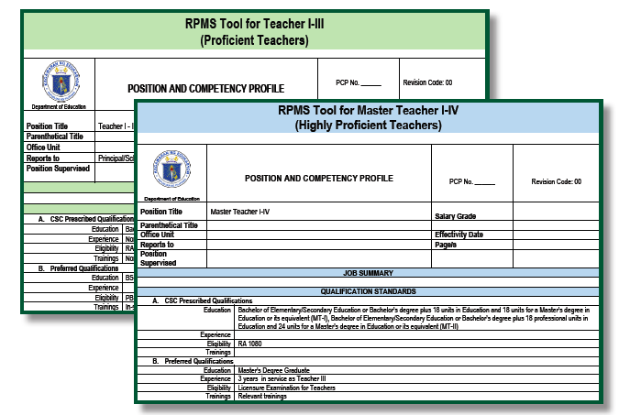
1. Position and Competency Profile

Slide 13
2. Job Summary (2.1 QS)

Slide 14
2. Job Summary (2.2 Duties and Responsibilities)
Teacher I-III
See page 133

Slide 15
2. Job Summary (2.2 Duties and Responsibilities)
See page 153
Master Teacher I-IV
1. Models exemplary practice in the application of content knowledge and pedagogy showing its integration within and across learning areas.

Slide 16
2. Job Summary (2.2 Duties and Responsibilities)
See page 153
Master Teacher I-IV
2. Conducts in-depth studies or action researches on teaching-learning innovations.

Slide 17
2. Job Summary (2.2 Duties and Responsibilities)
See page 153
Master Teacher I-IV
3. Works with colleagues to create learning-focused environments that promote learner responsibility and achievement.

Slide 18
2. Job Summary (2.2 Duties and Responsibilities)
See page 153
Master Teacher I-IV
4. Assists colleagues to implement differentiated teaching strategies that are responsive to learner diversity.

Slide 19
2. Job Summary (2.2 Duties and Responsibilities)
See page 153
Master Teacher I-IV
5. Leads in the preparation and enrichment of curriculum.

Slide 20
2. Job Summary (2.2 Duties and Responsibilities)
See page 153
Master Teacher I-IV
6. Initiate programs and projects that can enhance the curriculum and its implementation.

Slide 21
2. Job Summary (2.2 Duties and Responsibilities)
See page 153
Master Teacher I-IV
7. Leads colleagues in the design, evaluation, interpretation and utilization of different types of assessment tools for the improvement of the teaching and learning process.

Slide 22
2. Job Summary (2.2 Duties and Responsibilities)
See page 153
Master Teacher I-IV
8. Updates parents/guardians on learner needs, progress and achievement.

Slide 23
2. Job Summary (2.2 Duties and Responsibilities)
See page 153
Master Teacher I-IV
9. Strengthens school-community partnerships to enrich engagements of internal and external stakeholders in the educative process..

Slide 24
2. Job Summary (2.2 Duties and Responsibilities)
See page 153
Master Teacher I-IV
10. Establishes links with colleagues through attendance and membership in professional organizations to self-growth and advancement.

Slide 25
2. Job Summary (2.2 Duties and Responsibilities)
See page 153
Master Teacher I-IV
11. Provides technical assistance through demonstration teaching, mentoring, coaching, class monitoring and observation, organizing/leading/serving as trainers/facilitators in teacher quality circles/learning action cells.

Slide 26
2. Job Summary (2.2 Duties and Responsibilities)
See page 153
Master Teacher I-IV
12. Does related work.

Slide 27
2. Job Summary (2.2 Duties and Responsibilities)
See page 153
Master Teacher I-IV

Slide 28
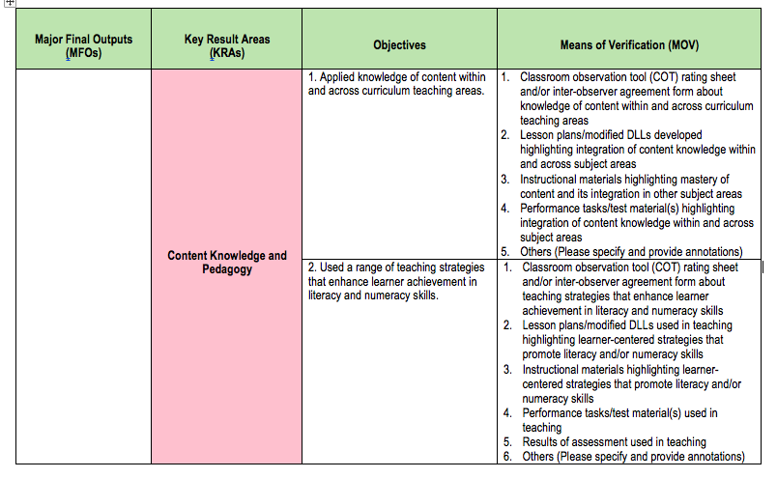
3. MFOs, KRAs, Objectives and MOVs
See page 134-

Slide 29
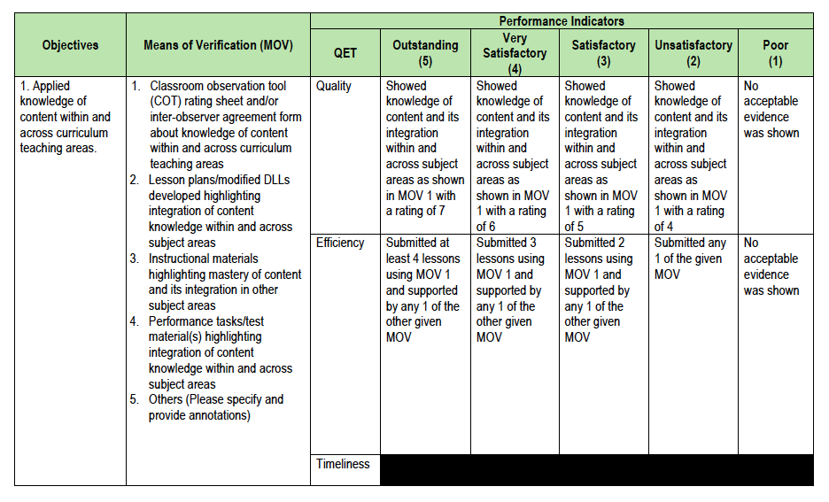
4. Objectives, MOVs, PIs

Slide 30
Performance Indicators include the following:
Notes:
The performance indicators need not have all three (3) categories. Some performance may only be rated on quality and efficiency, some on quality and timeliness and others on efficiency only. Figure 1.9 illustrates how the performance measures are embedded in the performance indicators of the RPMS Tools.
If and when the participants ask the participants ask how to compute for the COT rating for Quality, See Figure 29, Chapter 3: Portfolio Assessment

Slide 31
RPMS TOOLS
WHY
is there a need for RPMS Tools?

Slide 32
It serves as a BLUE PRINT
for teachers
to guide them
in accomplishing their job.
***Photo credits: from Google Photos
Notes:
Performance Indicators his part provides the exact quantification of objectives, which shall serve as the assessment tool that gauges whether performance is positive or negative (DO No. 2 s. 2015).
In the RPMS Tools, the performance indicators provide descriptions of quality and quantity given five performance levels: 5-Outstanding, 4-Very Satisfactory, 3-Satisfactory, 2-Unsatisfactory, and 1-Poor. Embedded in the performance indicators are elements of quality, efficiency and timeliness.
Means of Verification (MOV). The MOV column gives Ratees and Raters examples of documents that can prove the teachers’ attainment of objectives. They have been judiciously selected to show evidence of attainment of objectives. Teachers gather, select, organize and annotate MOV to help Raters in assessing teacher performance.
Also, MOV include classroom observation tool (COT); lesson plans/modified daily lesson logs; instructional materials; formative and summative assessment tools; compilations of student outputs; and others

Slide 33
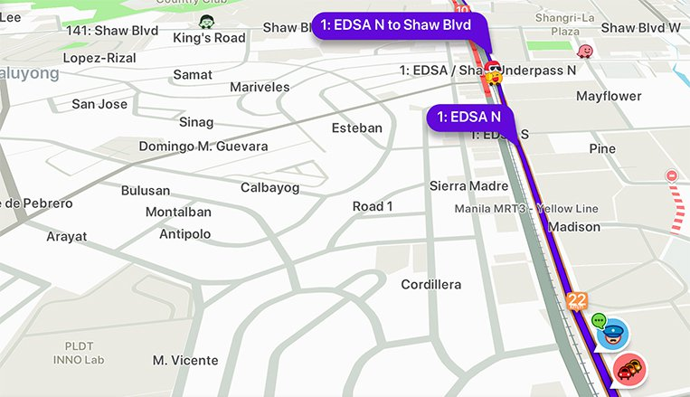
It also serves as a WAZE for teachers
to guide them in going to their target destination in reaching outstanding performance and redirect them once they are lost along the process.

Slide 34
RPMS TOOLS
WHO
uses the RPMS Tools?

Slide 35
WHO Uses the RPMS Tools?
RATERS
School Heads
Head Teachers
RATEES
Teachers I-III (Proficient Teachers)
Master Teachers I-IV (Highly Proficient Teachers)
Master Teachers
Department Heads
Designated Teachers-in-Charge
***for SHS

Slide 36
Raters (per DO 2, s. 2015)
Ratee | Rater | Approving Authority
Head Teacher/Master Teacher | Principal | Superintendent (Small & Medium Divisions) Asst. Superintendent (Large and Very Large Divisions)
Teacher | Head Teacher/Master Teacher | Principal
Notes:
POSSSIBLE ISSUES TO BE ANSWERED IF NEEDED
For ALS teachers, the Rater will be:
EPS II of ALS
CID Chief, in the absence of the EPS II
other personnel delegated by CID Chief
For clustered school
Ratee: Teacher
Rater: TIC (SO by SDS)
Approving Authority: Cluster Principal

Slide 37
In the case of Head Teacher:
For elementary, HT serving as School Head may use their OPCRF aligned to the existing NCBSSH.
For secondary, HT with teaching load, may use the Highly Proficient Tools for Master Teacher I-IV; HT without teaching load but serving as Department Head may craft their IPCRF anchored on the OPCRF of the Principal.
Notes:
NOTE:
Remember PPST is for TEACHERS not for Educational Leaders such as School Heads, same goes with RPMS Tools.

Slide 38
Walkthrough on the RPMS Tools for Teachers

Slide 39
Year 1 (2018) - 12 RPMS Indicators (baseline)
Rationale for the use of only 2 RPMS Tools
Proficient Teacher Indicators are met
Outstanding? Very Satisfactory? Satisfactory?
Teacher I-III
RPMS Tool for Proficient Teachers
Support for professional development to meet the indicators
Proficient Teacher Indicators are not met
Year 2 (2019)
+12 Indicators
Year 3 (2020)
+ 13 Indicators
Outstanding? Very Satisfactory? Satisfactory?
HP Teacher Indicators are met
Master
Teacher I-IV
Data we can get from schools:
Who are meeting the Indicators?
How many are meeting the Indicators?
What Indicators are met? What Indicators are not met?
RPMS Tool for Highly Proficient Teachers
HP Teacher Indicators are not met
Support for professional development to meet the indicators
Notes:
For year 1 (2018): There is a need for baseline data on where/what career stage teachers are currently at using the 12 “priority” indicators. During the first year of implementation, the 2 tools will determine whether indicators are met or not met. Those In the year 2 of implementation, another 12 indicators of the PPST will be used in the RPMS. The remaining 13 PPST indicators will be used the RPMS in the Year 3.

Slide 40
Rationale for the use of only 2 RPMS Tools
There is a need for baseline data on where/what career stage teachers are currently at using the 12 “priority” indicators.
RPMS Tool for Teachers I-III:
Many newly-hired teachers (Teacher I) in the field are not actually Beginning Teachers. Most of them already rendered service and came from private schools.
Teachers who use this tool/are rated using this tool may be found to be performing at a Proficient, below Proficient (Beginning) or beyond Proficient (Highly Proficient).

Slide 41
RPMS Tool for Master Teachers I-IV:
There’s a possibility that Master Teachers are not performing at the Highly Proficient Teacher career stage.
Teachers who use this tool/are rated using this tool may be found to be performing at a Highly Proficient, below Highly Proficient (Proficient) or beyond Highly Proficient (Distinguished).

Slide 42
Philippine Professional Standards for Teachers (PPST)
Key Result Areas
Objectives
Notes:
PPST is the basis
KRAs represent the Domains of PPST
Objectives represent the Indicators of the PPST
NOTE THE PAGE OF EACH KRA AND OBJECTIVE FOR CLEARER WALKTHROUGH.

Slide 43
Activity 2
Instructions:
Arrange the strips of papers that contain texts/words taken from the RPMS tools (e.g. KRA 1, Performance Indicators, Qualification Standards, Means of Verification), to which RPMS tools they belong.
Notes:
Give the participants strips of papers that contain texts taken from the different parts of the RPMS Tools (e.g. Qualification Standards, Duties and Responsibilities, Means of Verification, among others). Ask them to group the strips of papers as to which RPMS Tool they belong.

Slide 44
Were you able to place all texts in the correct column?
What made you accomplish the task?
Has your perspective about RPMS tools changed? Explain your answer.
Notes:
After the activity, ask the participants the processing questions.

Slide 45
RPMS TOOLS

Slide 46
Thank you!

